Slide 1
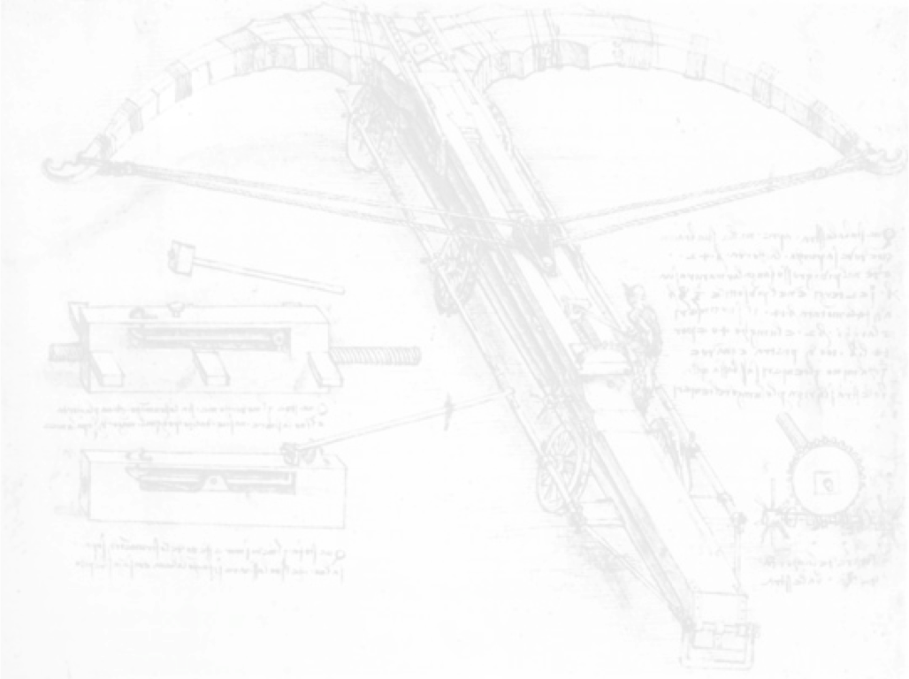
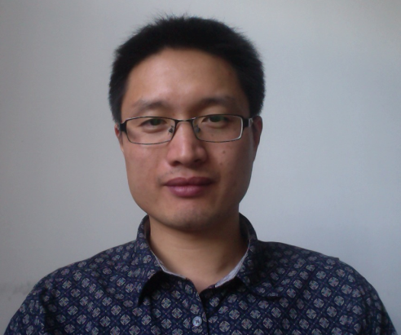
Chinese Initiatives on Future Circular Collider
Hongbo Zhu (IHEP)
On behalf of the CEPC-SppC Study Group
“Next Steps in the Energy Frontier – Hadron Colliders”
FermiLab, 25-29 August 2014

Slide 2
After the Higgs Discovery
Higgs factory ideas bloom
photo credit: symmetry

Slide 3
Chinese Proposal
The idea of Circular Electron Positron Collider (CEPC) as Higgs Factory proposed at several national “Accelerator Based HEP Program” workshops in 2011-2012, even before the Higgs discovery
At the workshop in September 2012, the idea to upgrade CEPC to a 50-70 TeV pp collider (SppC) adds life and physics potentials to the project; the option of CEPC-SppC seriously discussed in October 2012; the CEPC-SppC kick-off meeting on 13-14 September 2013
Presented by Dr Qing QIN at HF2012

Slide 4
In Practice
Dr Y. Wang’s talk at the FCC kickoff meeting
A circular Higgs factory fits our strategic needs in terms of
Science (great & definite physics)
Timing (after BEPCII)
Technological feasibility (experience at BEPC/BEPCII and other machines in the world),
Manpower reality (our hands are free after ~2020)
Economical scale (although slightly too high)
The risk of no-new-physics is complement by a pp collider in the same tunnel
A definite path to the future
A unique position for China to contribute at this moment:
Economical growth → new funding to the community
Large & young population → new blood to the community
Affordable tunnel & infrastructure
If no new project, no new resources → It is a pity if we miss it

Slide 5
Outline
Circular Electron Positron Collider (CEPC)
Physics motivation
Accelerator design
Detector design
Super proton-proton Collider (SppC)
Physics motivation
Accelerator design
Superconducting magnets
Timeline, organization, candidate site …
Summary

Slide 6
Circular Electron Positron Collider (CEPC)

Slide 7
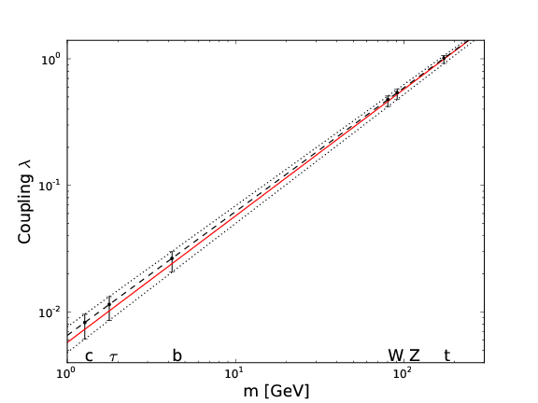
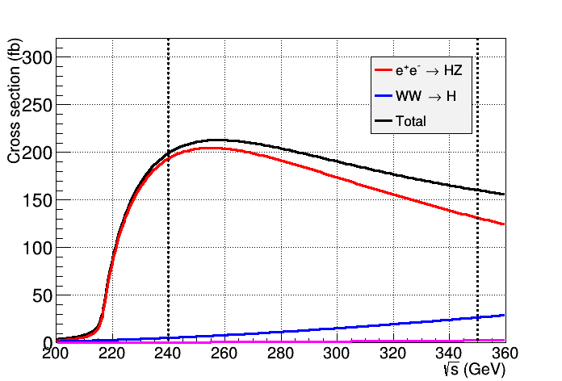
Physics Motivation
Precise measurements of the Higgs properties as a Higgs Factory and similar to ILC@250 GeV
Mass, J^{PC}, couplings, etc. → (sub-)percentage accuracy
Precise measurements of Electroweak Symmetry-Breaking parameters (machine operated at Z-pole/WW threshold)
and etc. + searches for rare decays
arXiv:1303.3879 [hep-ph]

Slide 8
Accelerator Baseline Design
LINAC | to generate and accelerate electrons to 6 GeV
Booster | to accelerate electrons to 120 GeV
Main Ring | to accumulate electrons to 16.9 mA, FODO lattice, single ring with the Pretzel scheme …
e+
IP1
e-
LTB
e+ e- Linac
(240m)
BTC
BTC
Booster(50Km)
CEPC Collider Ring(50Km)
IP2
More details in Dr Qing QIN’s talk

Slide 9
Basic Machine Parameters
CEPC machine parameters
Number of IPs |  | 2 | Emittance x/y | nm | 6.9/0.021
Beam energy | GeV | 120 | Transverse σ_{IP} x/y | μm | 74.3/0.16
Circumference | km | 50 | ξ_{x}/IP |  | 0.097
SR loss/turn | GeV | 3 | ξ_{y}/IP |  | 0.068
N_{e}/bunch |  | 3.5×10¹¹ | VRF | GeV | 6.87
Bunch number |  | 50 | Nature bunch length σ_{Z} | mm | 2.12
Beam current | mA | 16.9 | Bunch length includes BS | mm | 2.42
SR power/beam | mW | 50 | Nature energy spread | % | 0.13
B₀ | T | 0.065 | Energy acceptance RF | % | 5.4
Bending radius | km | 6 | nγ |  | 0.22
Momentum compaction factor |  | 0.4×10⁻⁴ | δ_{BS} | % | 0.07
β_{IP} x/y | mm | 800/1.2 | L_{max}/IP | cm⁻²s⁻¹ | 1.76×10³⁴

Slide 10
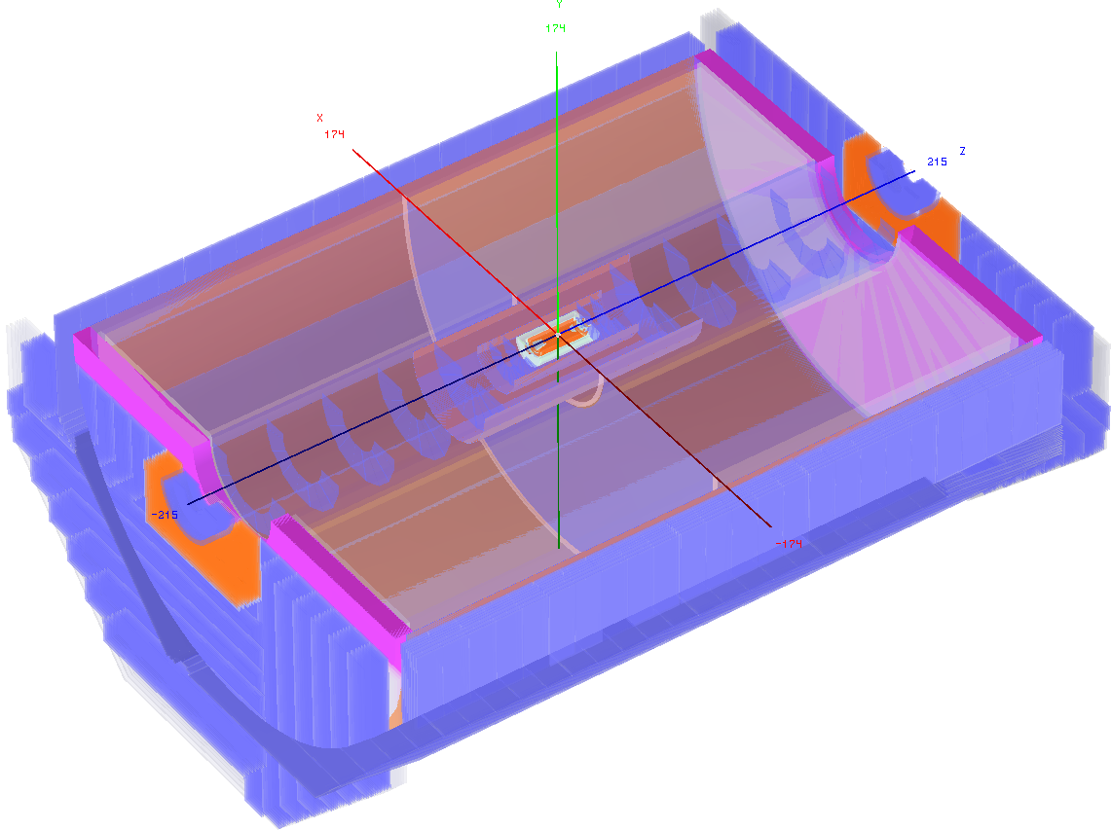
Detector Concept
ILD-like detector with additional considerations (incomplete list):
Shorter L* (1.5/2.5m) → constraints on space for the Si/TPC tracker
No power-pulsing → lower granularity of vertex detector and calorimeter
Limited CM (up to 250 GeV) → calorimeters of reduced size
Lower radiation background → vertex detector closer to IP
…
Similar performance requirements to ILC detectors
Momentum: ← recoiled Higgs mass
Impact parameter: ← flavor tagging, BR
Jet energy: ← W/Z di-jet mass separation
…

Slide 11
Vertex Detector
Pixel detector technologies on the market: CMOS Pixel Sensor (CPS), DEPFET, SOI, CCD, hybrid with 3D interconnection … and operation experience from other experiments, e.g.
CPS: STAR PX (MIMOSA28), ALICE ITS upgrade (MISTRAL/ASTRAL)
DEPFET: Belle II vertex detector
Without power-pulsing, it is difficult to remove heat sufficiently with air-cooling, possible solutions:
Extra cooling material/larger pixel size → degraded performance
Innovative readout architecture with lower power consumption or novel cooling technology (e.g. micro-channel cooling)
Preliminary study reveals radiation background likely lower than ILC → placing the vertex detector closer to IP to improve c-tagging
Detailed studies required to understand the impacts on physics performance

Slide 12
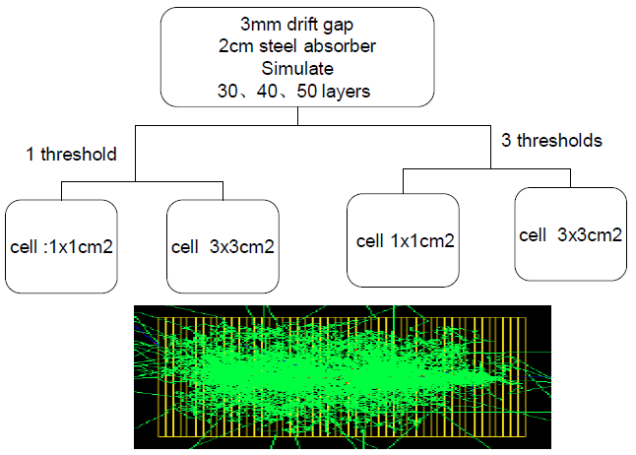
Calorimeters
Particle Flow Algorithm (PFA) driven calorimeters extensively explored by the CALICE collaboration; have started investigating the following technologies:
DHCAL(ThGEM, RPC), SDHCAL (RPC), ECAL (SciW, SiW)
Without power-pulsing, cooling of high-granularity calorimeters challenging due to the huge number of electronics channels → less segmentation → degraded detector performance
Detailed studies required to understand the impacts on physics performance

Slide 13
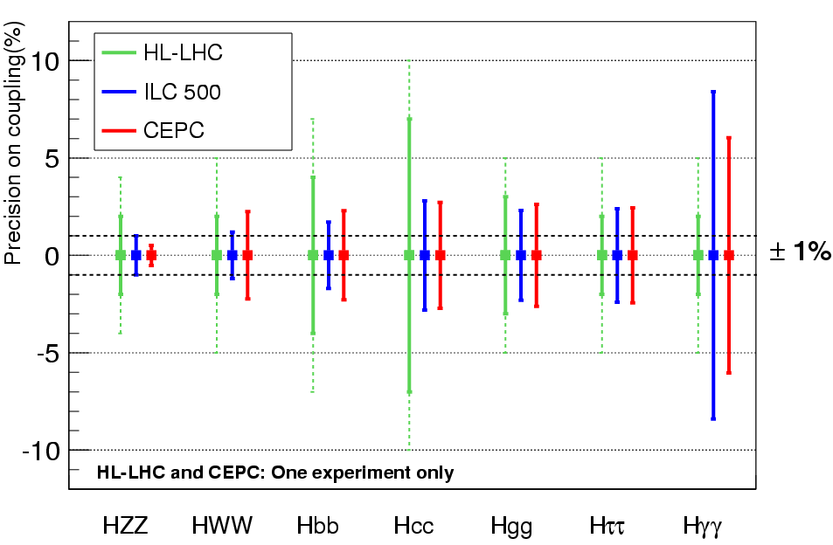
Higgs Couplings
Comparison of the expected precision on Higgs couplings measurements from HL-LHC, ILC and CEPC.
HL-LHC: 3 ab⁻¹, one detector with the following assumption:
ILC 500: 250 fb⁻¹@250 GeV + 500 fb⁻¹@500 GeV
CEPC: 2.5 ab⁻¹ @ 250 GeV, one detector
e+e- collider ideally suited for measuring H→invisibles
And eventually a combination of results from all experiments …

Slide 14
Super proton-proton Collider (SppC)

Slide 15
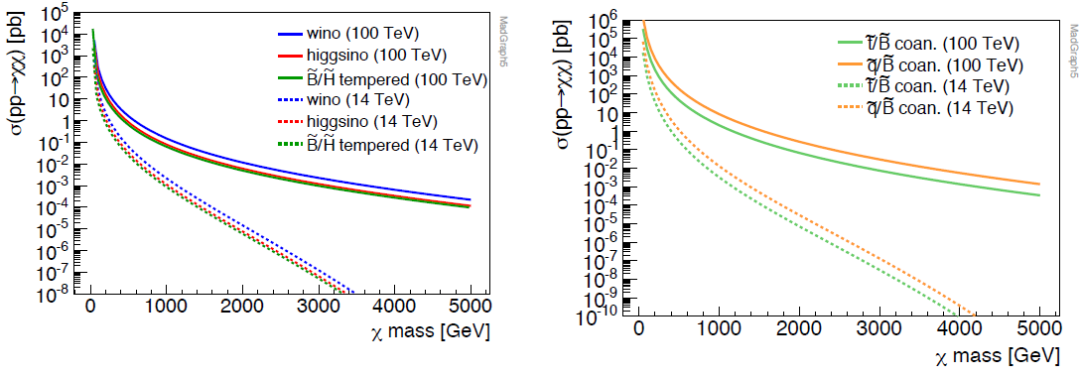
Physics Motivation
High center-of-mass energy of O(100 TeV) allows for direct searches for New Physics like SUSY, Extra Dimensions, etc. → unprecedented physics potentials
To or not to re-define the physics program upon the (HL-)LHC results yet to come …
Dr L. Wang’s talk at 1st CFHEP Symposium
More discussion at this workshop …

Slide 16
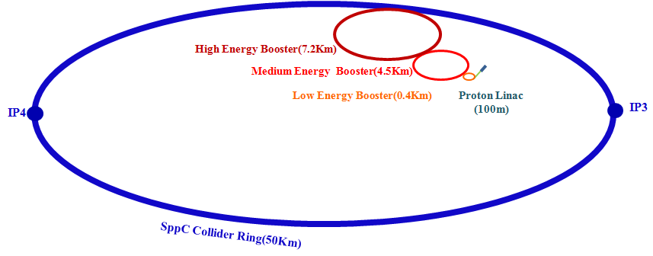
Accelerator Baseline Design considerations
Proton-proton collider luminosity
Main constraint: high-field superconducting dipole magnets
50 km: B_{max} = 12 T, E = 50 TeV
50 km: B_{max} = 20 T, E = 70 TeV
70 km: B_{max} = 20 T, E = 90 TeV

Slide 17
Basic Machine Parameters
work in progress
SppC Machine Parameters | Option 1 | Option 2
Beam energy [TeV] | 25 | 45
Circumference [km] | 50 | 70
SR loss/turn [keV] | 440 | 4090
Bunch population | 1.3 ×10¹¹ | 0.98×10¹¹
Bunch numbers | 3000 | 6000
Beam current [mA] | 0.5 | 0.405
SR power/beam (MW) | 0.22 | 1.66
B₀ [T] | 12 | 19.24
Bending radius [km] | 6.9 | 7.8
Momentum compaction factor | 3.5×10⁻⁴ | 2.5×10⁻⁴
β_{IP} x/y (m) | 0.1/0.1 | 0.1/0.1
Emittance (μm·rad) | 4 | 3
ξ_{y}/IP | 0.004 | 0.004
Luminosity/IP (cm⁻²s⁻¹) | 2.15×10³⁵ | 2.85×10³⁵

Slide 18
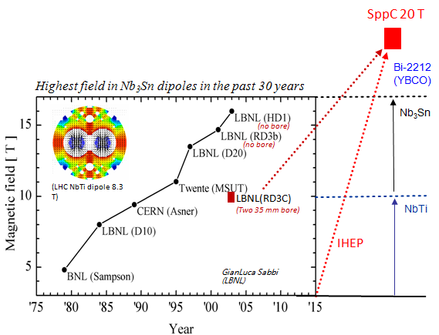
High-field Magnets
High-field dipole magnetic field for SppC (B_{max} = 20 T) - Challenging
Nb₃Sn dipole magnetic field records:
11 T achieved with double-aperture (MSUT @4.4K, Twente U, 1995)
13.5 T achieved with single-aperture (D20 @1.8K, LBNL, 1997)
Current operational field 8.3 T (LHC main dipole)
Nb₃Sn dipoles approaching the conductor limits; necessary to develop HTS technology toward 18 – 20 T
Nb₃Sn alone cannot yield the desired 20 T for SppC dipole magnet. Combination of Nb₃Sn (15 T) + HTS (5 T) is considered, which will require 10 -15 years of intensive R&D on Nb₃Sn/HTS technologies.

Slide 19
Tentative R&D Roadmap
Nb₃Sn + HTS
2015 – 2020 | Develop 12 T Nb₃Sn double-aperture dipole magnet Conduct basic technology research on HTS materials and wires and prototype an inserted coil of 2 – 3 T
2020 – 2025 | Develop 15 T Nb₃Sn double-aperture dipole/quadrapole magnets Conduct basic technology research on HTS materials and wires and prototype an inserted coil of 4 – 5 T
2025 – 2030 | Develop Nb₃Sn (15 T) + HTS (5 T) or HTS (20 T) dipole magnet
2030 – 2035 | Knowledge and experience transfer to industry, enabling mass production
Request for short/long term research funding (in preparation)
Joint venture with institutes/companies started, e.g. Western Superconducting Technologies Co. Ltd. (main supplier to ITER)
Global efforts to develop superconducting magnet technology

Slide 20
CEPC-SppC Project Timeline (dream)
CEPC
 |  | 2015 |  |  |  |  | 2020 |  |  |  |  | 2025 |  |  |  |  | 2030 |  |  |  |  | 2035
Pre-studies (2013-2015)
R&D Engineering Design (2016-2020)
Construction (2021-2027)
Data taking (2028-2035)
1st Milestone: pre-CDR (by the end of 2014) → R&D funding request to Chinese government in 2015 (China’s 13th Five-Year Plan 2016-2020)
SppC
 |  | 2020 |  |  |  |  |  |  | 2030 |  |  |  |  |  |  |  |  | 2040
R&D (2014-2030)
Engineering Design (2030-2035)
Construction (3035-2042)
Data taking (2042-2055)

Slide 21
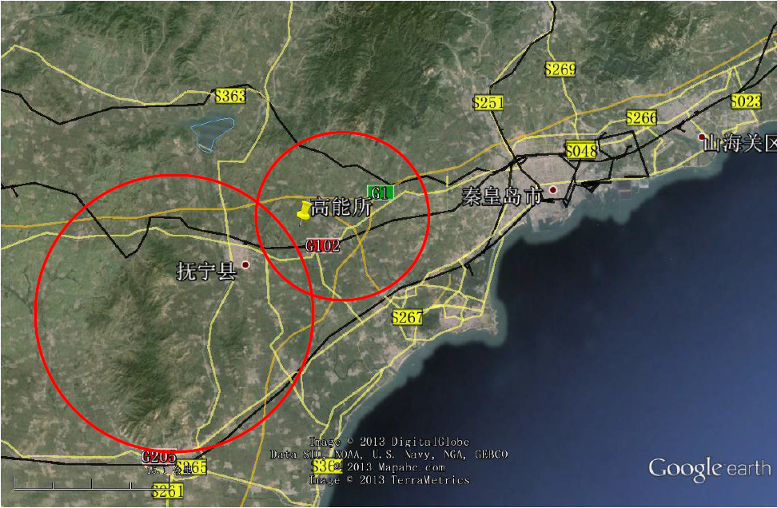
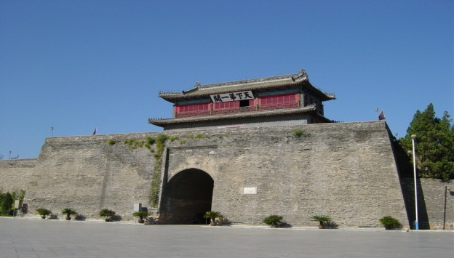
Candidate Site
Preliminarily selected: Qinghuangdao (秦皇岛), 300 km from Beijing, with great geological conditions and strong support from the local municipal government
Detailed geologic survey and conceptual design efforts of civil engineering already started
Starting point of the Great Wall

Slide 22
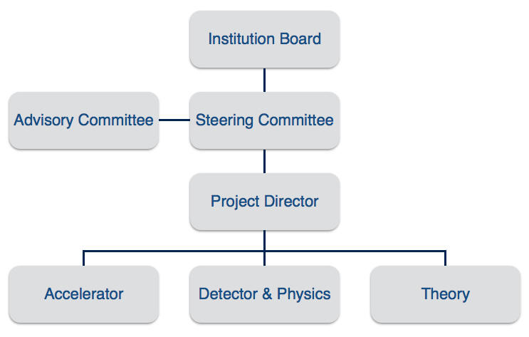
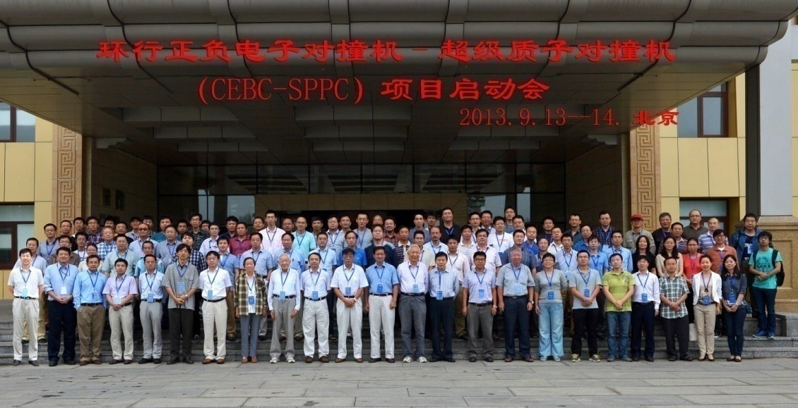
Organization
Institution Board and Steering Committee formed in the kick-off meeting in September 2013; conveners appointed for the three working groups: Accelerator, Theory and Detector & Physics
Find out more: http://cepc.ihep.ac.cn/index.html
International workshops and regular group meetings to coordinate efforts
Schools and hand-on tutorials to train students – important to inspire more young people to directly participate in the activities

Slide 23
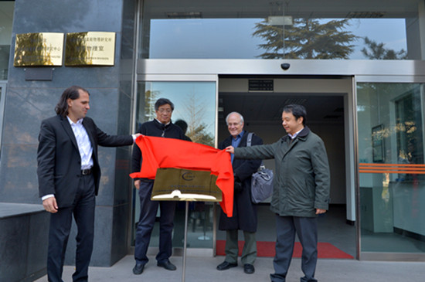
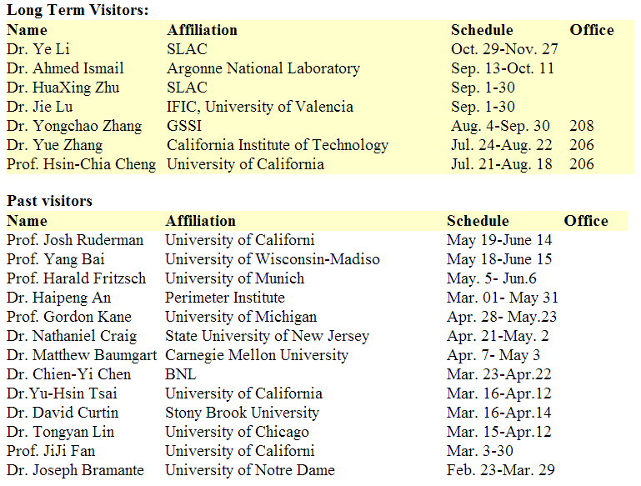
Internationalization
Center for Future High Energy Physics (CFHEP) established on 17 December 2013, with Prof. Nima Arkani-Hamed as its first director
Started inviting theorists (and now accelerator physicists) to come to IHEP and work together with local members on related topics
Intended to invite experts in all relevant fields → More are welcome!
A seed for an international lab, potentially organized and managed by the community

Slide 24
Pre-CDR
Writing up the preliminary Conceptual Design Report (pre-CDR), covering accelerator, theory, experiment (detector and physics), and civil engineering. → 1st milestone

Slide 25
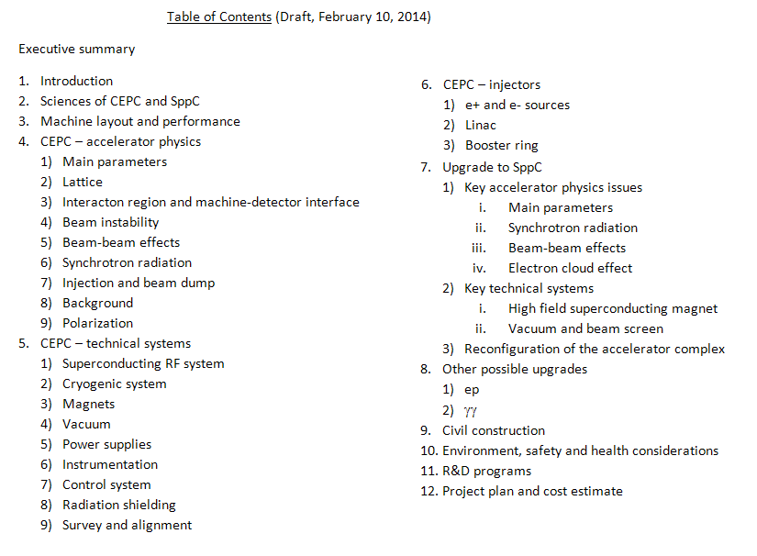
Pre-CDR: Accelerator
Most chapters ready for internal review
Theory/Detector & Physics chapters in similar status

Slide 26
Summary (personal remarks)
The proposal of CEPC-SppC, with the electron machine as its first step, balances well the physics goals and technical challenges together with economic affordability.
Writing up the pre-CDR helps identifying the most critical R&D items, enables the possibility to request R&D finding (China’s 13th Five-Year plan), and internationalize the project by getting more and more foreign experts involved.
CEPC-SppC would eventually re-shape the Chinese HEP community and enable more important Chinese contributions than ever to the international HEP community.
Precision measurements + New Physics
International collaboration is the only way to make this project possible. Join us!

Slide 27
Backup

Slide 28
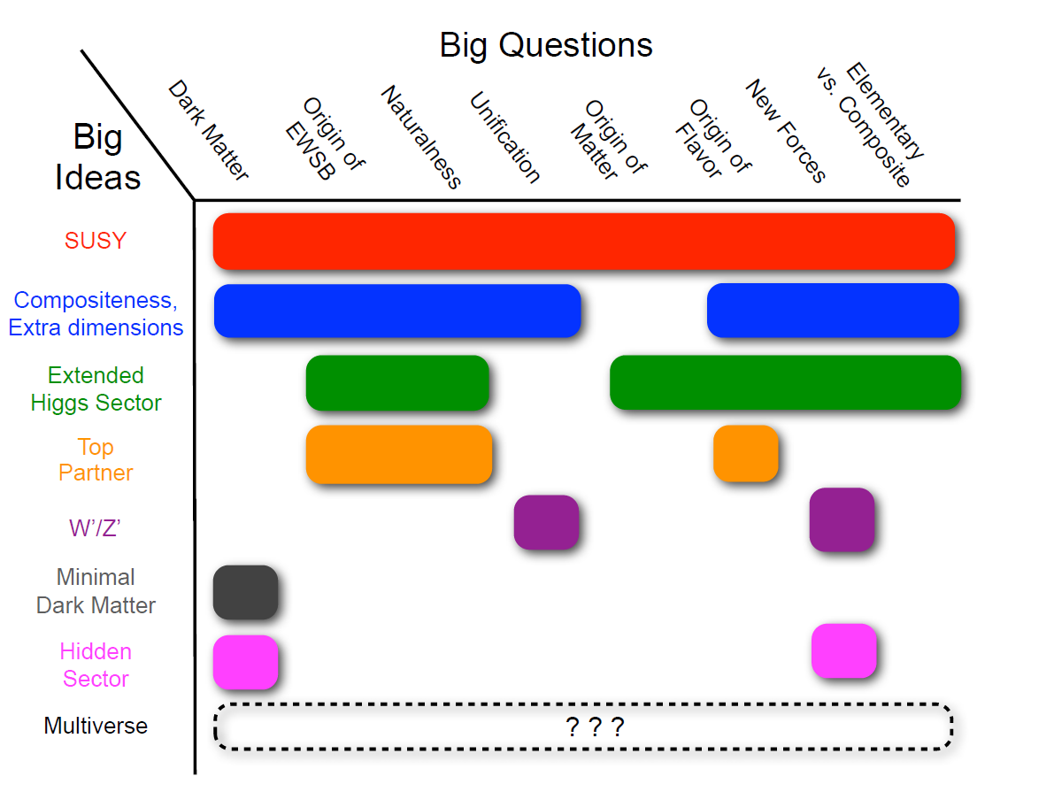
New Physics
Snowmass NP report

Slide 29
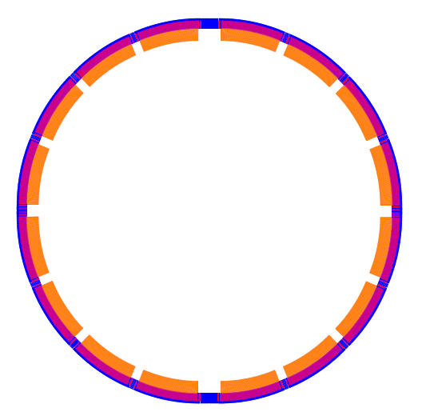
Critical Parameters
Circumference: 50 km
SR power: 50 MW/beam
16 *arcs
2 *IPs
8 RF cavity section (distributed)
6 straights (for injection and dump)
Filling factor of the ring: ~80%
IP1
RF
RF
RF
RF
CEPC
RF
RF
RF
RF
IP2

Slide 31
20 T magnet working group in China
newcomer
IHEP (Institute of High Energy Physics, Chinese Academy of Sciences)
Superconducting Magnet Engineering Center：10+ years R&D and production of superconducting solenoids for particle detectors and industries.
Accelerator Center Magnet Group：30+ years R&D and production of conventional accelerator magnets.
+ (staff): 10+ years R&D on superconducting magnets including 6 years on high field/ large aperture accelerator magnets at KEK & CERN.
NIN (Northwest Institute for Non-ferrous Metal Research) & WST (Western Superconducting Tech. Co.)
NIN: Advanced Bi-2212 R&D. Significant progress in past several years.
WST: Qualified Nb₃Sn supplier for ITER. High J_{c} Nb₃Sn R&D.
Tsinghua U. & Innost (Innova Superconductor Tech. Co.)
10+ years R&D and production of Bi-2223. Modification of production lines for Bi-2212 is under discussion.
Shanghai JiaoTong U.& SST (Shanghai Superconductor Tech. Co.)
YBCO R&D and production. Significant progress in past several years.
And other related institutes in China
CHMFL (High Magnetic Field Laboratory of the Chinese Academy of Sciences) Nb₃Sn CICC conductor & high field solenoids; advanced insulation materials;…

Slide 32
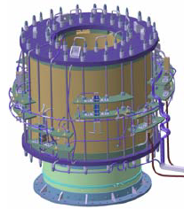
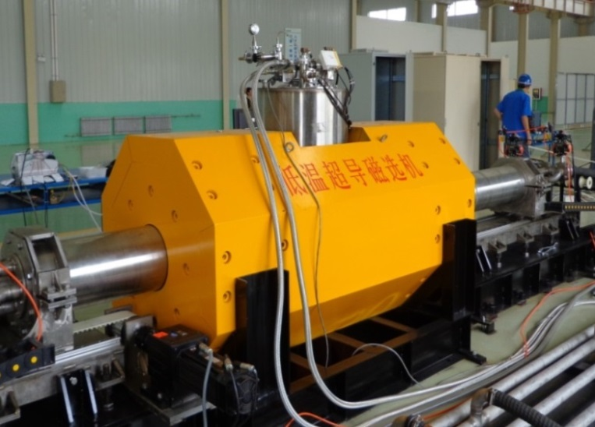
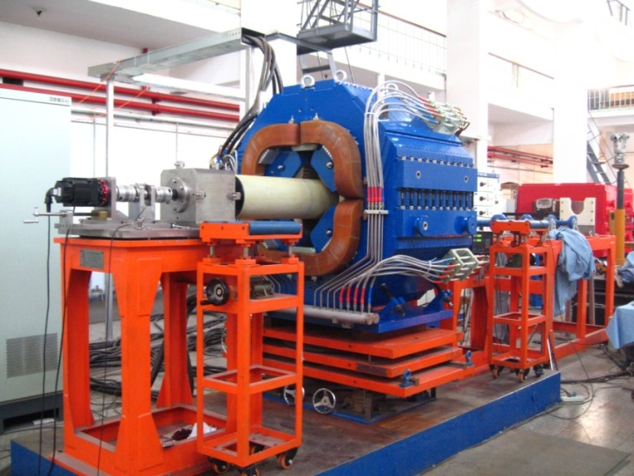
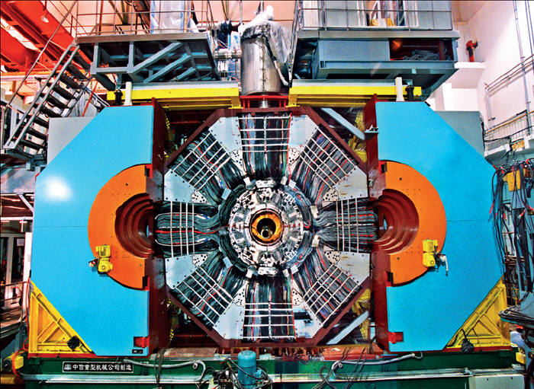
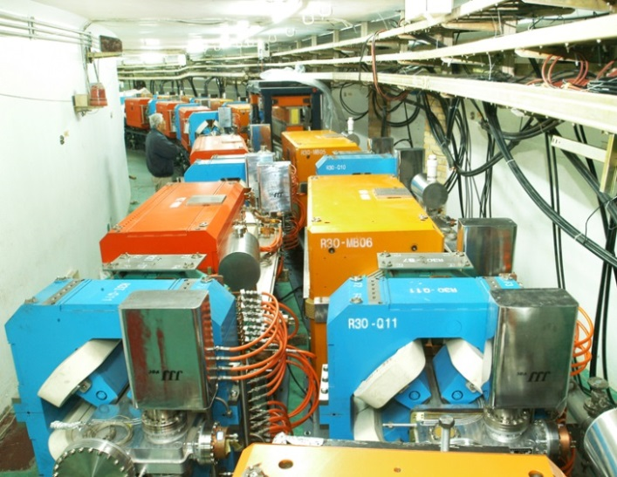
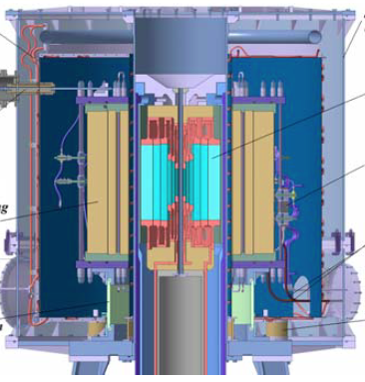
20 T magnet working group in China
newcomer
IHEP
CHMFL
Superconducting magnetic separator (2012)
25Hz AC quadruple for CSNS(2013)
11 T Nb₃Sn solenoid (ongoing)
BESIII Superconducting solenoid (2006)
Conventional magnets for BEPCII (2005)
11 T Nb₃Sn + 29 T Cu insert
(ongoing)

