Slide 1
GSA Introduction
Kenneth Smith
SUNY Buffalo

Slide 2
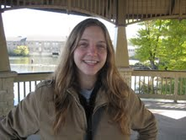
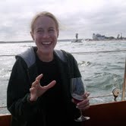
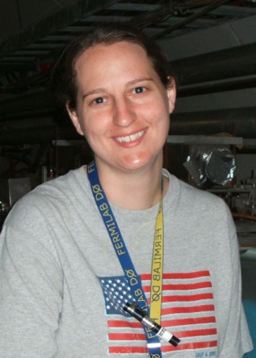
GSA Officers
Carley Kopecky, UC Davis, CMS
Sarah Lockwitz, Yale, CDF
Michelle Prewitt, Rice, DØ

Slide 3
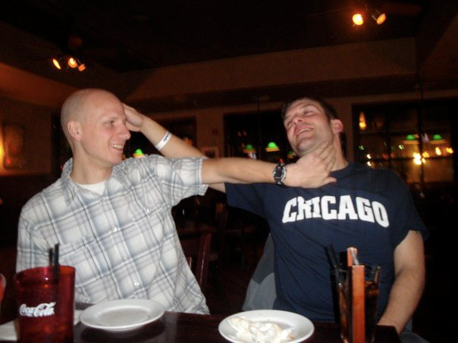
GSA Officers
Kenneth Smith, SUNY Buffalo, DØ
Mika Vesterinen, Manchester, DØ

Slide 4
Our Goal
Our goal is to make the life of an FNAL graduate student easier
For many students coming here, this is their third time moving to a new place
Information like where to live, area shopping, doctors, attractions etc. aren’t always easy to find
Making new friends isn’t always the easiest thing to do for a grad student either
We also provide a connection to the UEC to voice graduate student concerns

Slide 5
Resources
Guide to life
Has info on everything in the area:
Local schools, shopping, doctors, entertainment, living, recreation and much much more
http://www.fnal.gov/orgs/gsa/guide/index.html
FNAL grad mailing list
A great list for connecting to other grads for various reasons
Moving sales, info on upcoming events, suggestions on local services, and of course…. Moving help!!! (often free beer included!)
fnalgrad@fnal.gov

Slide 6
Social Activities
We attempt to put on a monthly pub night
June 17th, @ Quigley’s in Naperville at 7 P.M.

Slide 7
Social Activities
We attempt to put on a monthly pub night
June 17th, @ Quigley’s in Naperville at 7 P.M.
GSA BBQ (I met my wife @ 2007 BBQ)

Slide 8
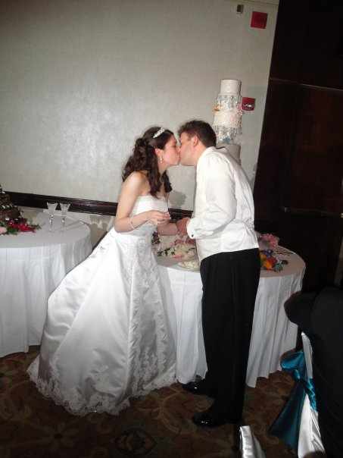
Social Activities
We attempt to put on a monthly pub night
June 17th, @ Quigley’s in Naperville at 7 P.M.
GSA BBQ (I met my wife @ 2007 BBQ)

Slide 9
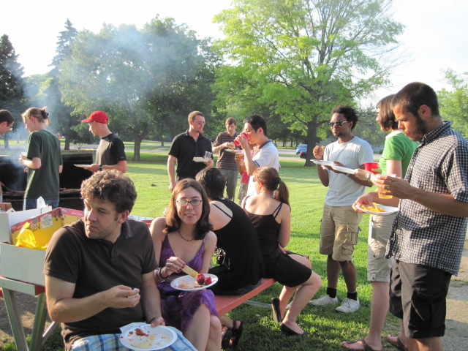
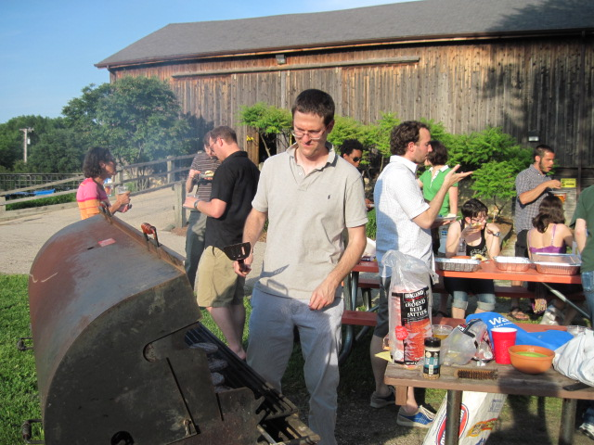
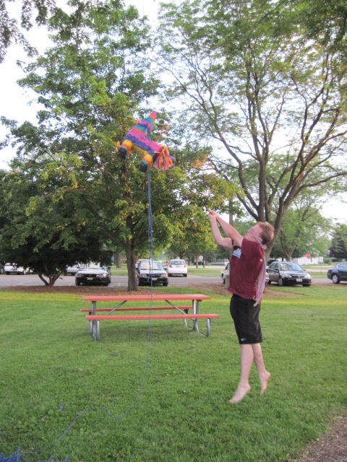
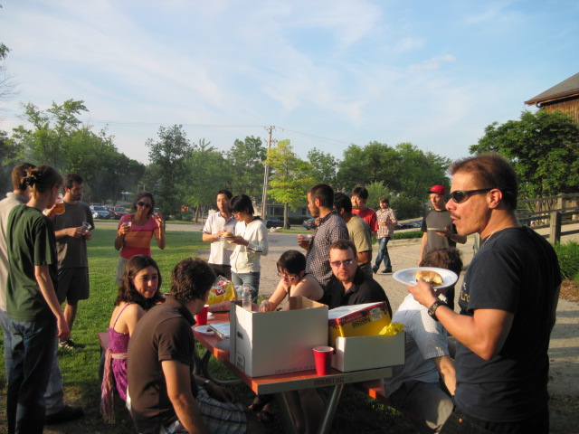
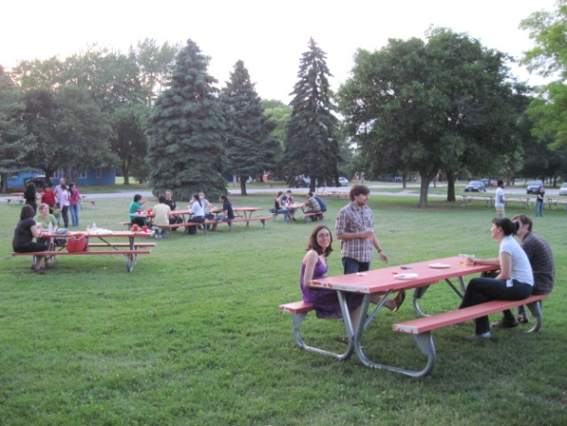
Social Activities
We attempt to put on a monthly pub night
June 17th, @ Quigley’s in Naperville at 7 P.M.
GSA BBQ

Slide 10
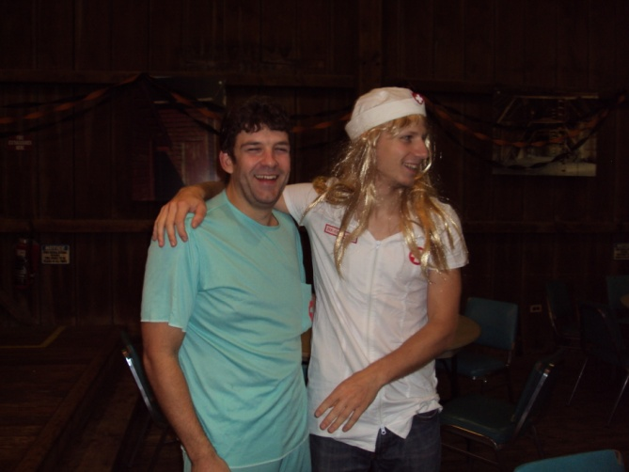
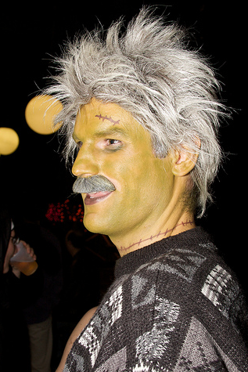
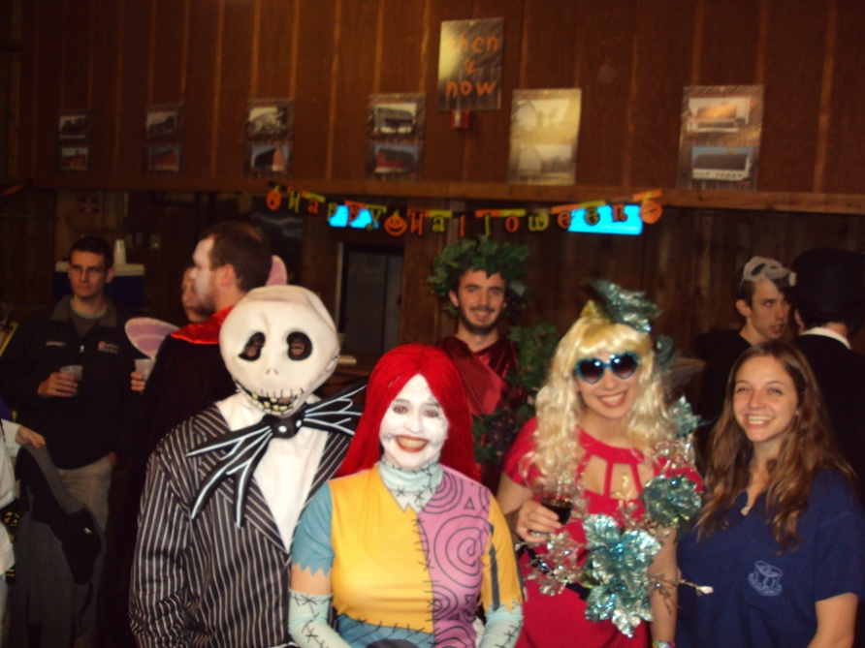
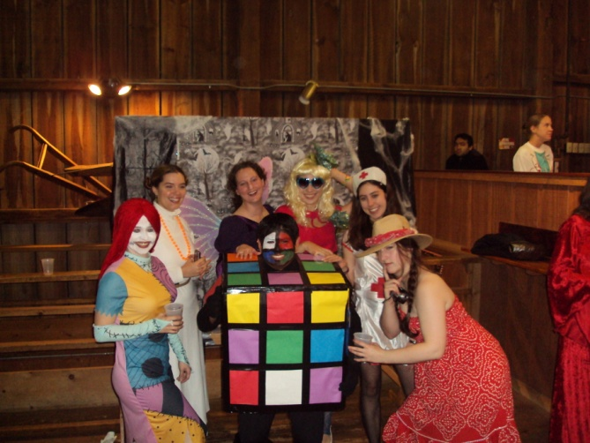
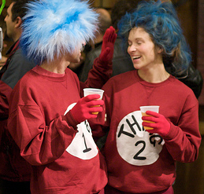
Social Activities
We attempt to put on a monthly pub night
June 17th, @ Quigley’s in Naperville at 7 P.M.
GSA BBQ
GSA Halloween night

Slide 11
Social Activities
We attempt to put on a monthly pub night
June 17th, two brothers on 59 at 7 P.M.
GSA BBQ
GSA Halloween night
Game nights
FREE poker tournaments to teach people how to play

Slide 12
Recreation
Recreation website offers many things
Discount movie tickets, passes for gym and pool, sports league information and more
http://wdrs.fnal.gov/recreation/index.html
Fermi ultimate frisbee
Played 5 P.M. Mondays and Wednesdays @ soccer field
fermiultimate@fnal.gov
Fermi soccer
Played just about every other day on soccer field at 5 P.M.
Fermilab triathlon
July 10th, 8:00 A.M.
Visit: http://www.fnal.gov/orgs/gsa/calendar/triathlon/tri10/

Slide 13
Washington, D.C. Trip

Slide 14
Washington, D.C. Trip
Got a chance to say thank you to representatives who work tirelessly to help fund our endeavors
Spoke about how their investment is paying off, and how important the funding is for the future
As graduate students, we are able to show what recent investments have blossomed into and that our field continues to have a strong future

Slide 15
Graduate Student Talks
Graduate students talks at this year’s user’s meeting
Nhan Tran, 16:05 Wednesday
Marcelle Soares-Santos, 15:50 Thursday
Please attend the poster session and banquet tonight starting at 5:30 in the atrium

