Slide 1
Development of a 6TeV Muon Collider Design
Min-Huey Wang, Yuri Nosochkov, Yunhai Cai
MAP 2014 Winter Meeting (3-7 Dec., 2014), SLAC USA

Slide 2
Outline
Introduction
Linear optics
Chromatic correction
Dynamic aperture optimization
Summary

Slide 3
Introduction
CMS energy 6 TeV (future high energy collider)
High luminosity
Low β∗ at IP
Small circumference (6.3 km)
Sufficient momentum acceptance
Sufficient dynamic aperture for a beam with normalized emittance of ~25 μmrad
Absence of long straights to avoid hot spot of neutrino radiation

Slide 4
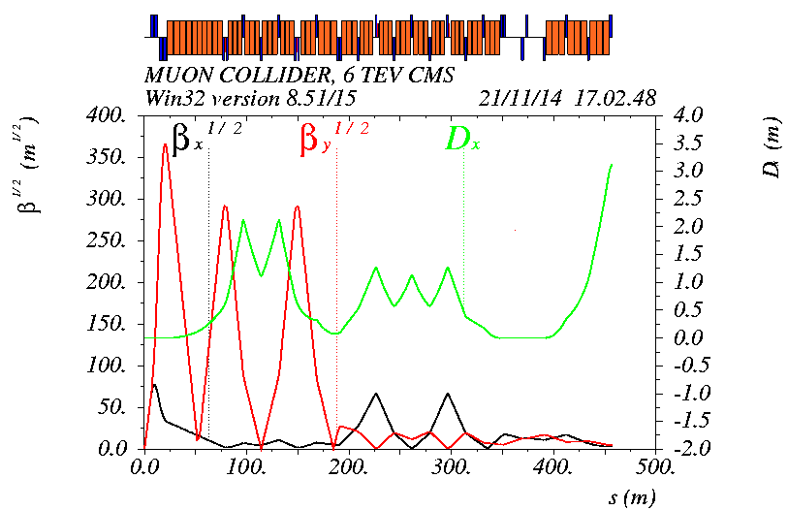
IR linear optics for 6 TeV design
-I
-I
DS
DS
Field@poletip:
<15 T in quads
<20 T in bends
β*_{x,y} =1 cm
IP
L* =6 m
β_{xmax} = 6.0 Km
β_{ymax} = 133.6 Km

Slide 5
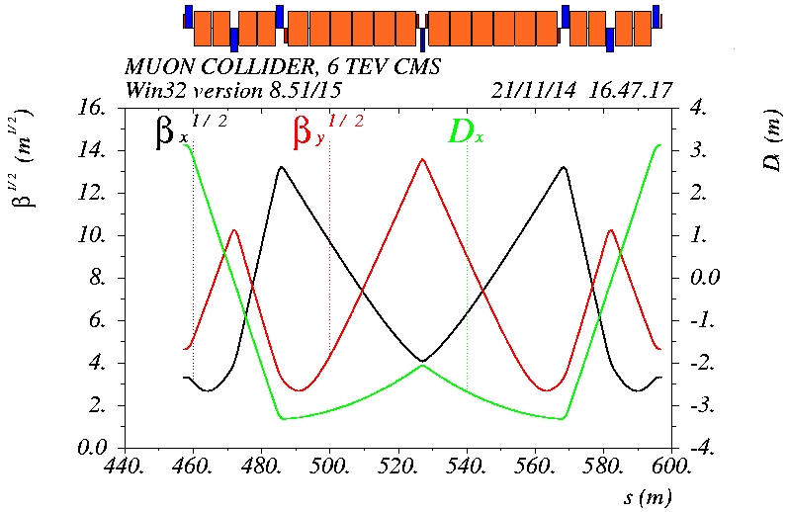
Arc cell linear optics for 6 TeV design
μ_{x}/μ_{y} = 0.875/0.875 $×$ 2π, 8 cells per quarter ring
Modification of the 1.5 TeV design (by Y. Alexahin et al)
Field increased with energy: < 15T in quads, < 20T in bends

Slide 6
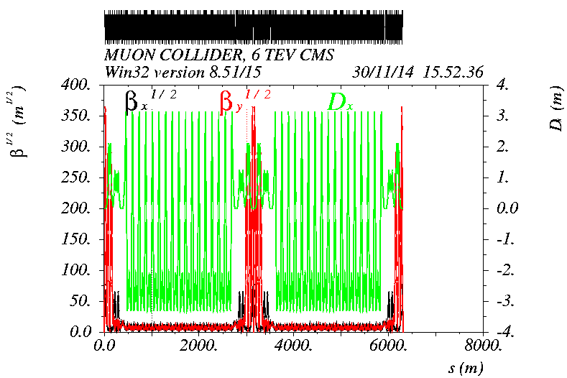
6 TeV complete ring linear optics
Two IPs, twofold symmetry
Circumference: 6.302km; ν_{x}/ν_{y} = 38.23/40.14

Slide 7
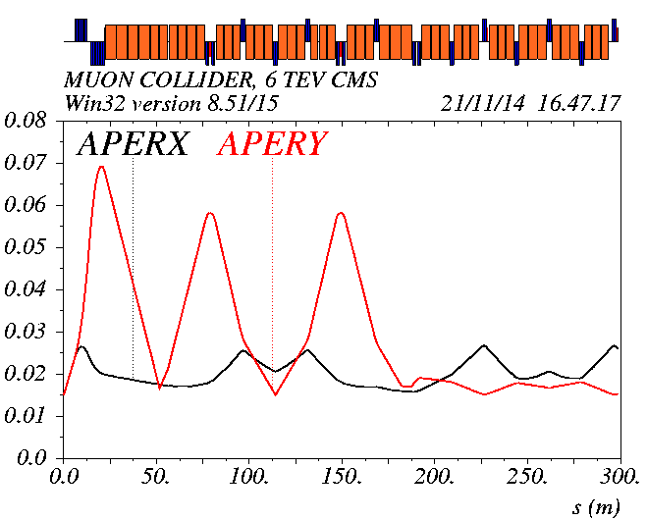
Aperture of IR magnets
(m)
The half aperture calculation in IR is based on the definition: 5σ_{x,y}+ 15 mm

Slide 8
IR Magnets
Magnet | Half-aperture | Pole tip field | Length
 | (mm) | (T) | (m)
QIR01A | 30 | 14.52 | 1.85
QIR01B | 35 | 14.52 | 1.85
QIR01C | 45 | 14.52 | 1.85
QIR02A | 65 | -14.94 | 2.2
QIR02B | 75 | -14.94 | 2.2
QIR02C | 75 | -14.94 | 2.2
QIR# | 60, 30, 25 | < 15 | 2 (1.7 QIR03,07)
Dipole | 50(66) | < 20 | 4/4.5/5.5

Slide 9
Main parameters
Parameter | Unit | 1.5 TeV design | 3 TeV design | 6 TeV design
Beam energy | TeV | 0.75 | 1.5 | 3.0
Number of IPs |  | 2 | 2 | 2
Circumference | m | 2730 | 2767 | 6302
β* | cm | 1 | 1 | 1
Tune x/y |  | 18.56/16.58 | 20.13/22.22 (temporary) | 38.23/40.14 (temporary)
Momentum compaction |  | -1.30E-5 | -2.88E-4 | -1.22E-3
Normalized emittance | (π)mm·mrad | 25 | 25 | 25
Momentum spread | % | 0.1 | 0.1 | 0.1
Bunch length | cm | 1 | 1 | 1
Muons/bunch | 10¹² | 2 | 2 | 2
Repetition rate | Hz | 15 | 15 | 15
Average luminosity | 10³⁴ cm⁻²s⁻¹ | 1.1 | 4.5 | 7.1
The average luminosity presented here does not take into account the BB or hourglass factor. The change of luminosity is due to beam energy and circumference.

Slide 10
Chromatic correction
Local correction of chromatic beta beat and higher order chromatic tune shift created by the final focus quads
Two –I pairs of x and y correction sextupoles placed nπ in x or y phase from the final focus quads
large x/y or y/x beta ratio at the IR sextupoles for orthogonal correction
cancellation of IR sextupole geometric aberrations
no other sextupoles within each IR sextupole pair to minimize octupole-like tune shift with amplitude
Phase advance of the arc cell (μ_{x} = 7/8 × 2π, μ_{y} = 7/8 × 2π) provides cancellation of the 3rd order and 4th order resonance driving terms locally in each 8-cell quarter ring (except 2ν_{x} −2ν_{y}).

Slide 11
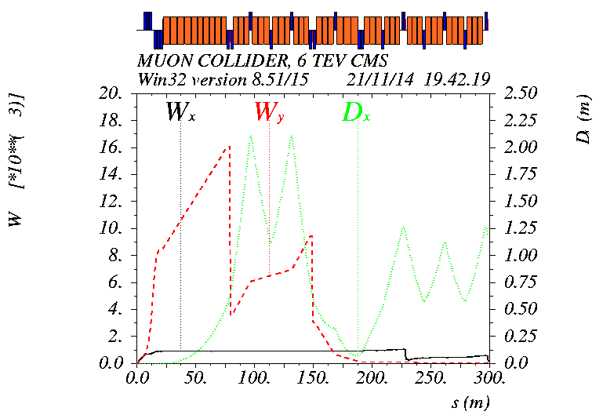
Cancellation of IR chromatic W-function
SD
-I
SF
-I
The W function is locally corrected using the –I sextupole pairs
The linear chromaticity is corrected using arc sextupoles

Slide 12
Beam dynamics properties before optimization
The vertical aperture is poor
Amplitude dependent tune
Amplitude tune
Tune footprint
Chromatic tune
No 0.5 % off- momentum particle survived
Large ν_{y} tune shift
Large chromatic ν_{x}

Slide 13
Dynamic aperture optimization
Correction of vertical amplitude dependent tune shift
Add one octupole at IR location with large beta-y and no dispersion
Correction of the effect of finite sextupole length
Add a pair of weak sextupoles near the main –I sextupoles, total two pairs are added.
Correction of horizontal chromatic tune shift
Add a –I pair of ± sign octupoles at location of large beta-x and dispersion
Improve off momentum dynamic aperture to 0.5%

Slide 14
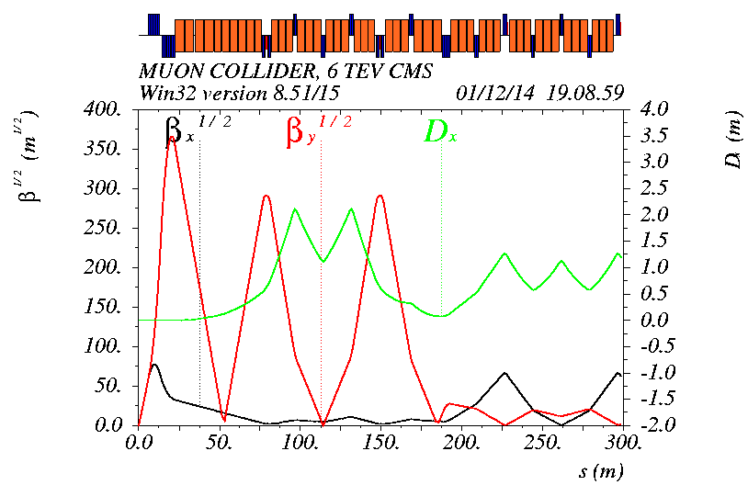
Knobs for nonlinear corrections
OCT1
weak sextupoles
OCT2 pair
IP
β_{xmax} = 6.0 Km
β_{ymax} = 133.6 Km

Slide 15
Add octupole OCT1 near the defocusing final doublet quadrupole
Oct1 = 0.0074(lego) correction of on momentum only
Amplitude tune
Tune footprint
Frequency Map
Increase oct1 strength,
gain off -momentum
vertical
aperture
Tune footprint
Amplitude dependent tune
The vertical amplitude dependent tune changes sign

Slide 16
Correction of the effect of finite sextupole length
Amplitude tune
Tune footprint
Frequency Map
Verify dynamic aperture using thin lense IR sextupoles
The length effect mainly comes from defocussing sextupoles where the beta y is huge
L is main sextupole length
K=0.5
$$2\left(7+6k\right)(\frac{S2}{S1})^{2}+12\left(1+k\right)\left(\frac{S2}{S1}\right)+1=0$$

Slide 17
Correction of horizontal chromatic tune using octupole pair
Amplitude tune
Tune footprint
Frequency Map
Add –I octupole pair with ± strengths on one side of the –I focusing sextupoles
Off-momentum dynamic aperture up to 0.5 %
Controlle the cubic term of the chromatic ν_{x}
Amplitude dependent tune

Slide 18
Optimized dynamic aperture
σ_{x}/σ_{y} @IP is 3 μm

Slide 19
Summary
A preliminary design of 6.3 km 6TeV CM energy muon collider ring is presented
The IR chromatic correction scheme uses –I non-interleaved pairs of sextupoles
The arc chromatic correction scheme provides local cancelation of sextupole resonance driving terms in each quarter ring
Orthogonal knobs are implemented to optimize the vertical amplitude dependent tune shift and horizontal chromatic tune shift
The momentum dynamic aperture of bare lattice is up to 0.5%

