Slide 1
MICE Demonstration of Ionisation Cooling
Colin Whyte
University of Strathclyde
On behalf of the MICE collaboration

Slide 2
Outline
MICE Experiment
STEP IV
Partial Return Yoke
Magnets and Alignment
Magnet cooling
Demonstration of Ionisation Cooling
RF Modules
Temperature
RF Power
RF distribution

Slide 3
MICE Experiment
Muon Ionisation Cooling Experiment is an international collaboration aiming to demonstrate that the emittance of a muon beam can be reduced, the muon beam can be “cooled”
Liquid Hydrogen and LiH absorbers.
Establish feasibility of muon accelerators for particle physics.
Enabling technology for investigating neutrino physics.
Capability to deliver constituent collisions more energetic than those that can be achieved at the LHC.
MICE will deliver the necessary, seminal, demonstration of cooling required for these future experiments.

Slide 4
MICE Experiment
MICE will be completed in 2 stages
Step IV
Measure absorber properties
liquid hydrogen
lithium hydride, LiH
Demonstration of Ionisation Cooling
Demonstrate cooling of Muon beam using LiH absorber with re-acceleration from 2 normally conducting RF cavities.

Slide 5
MICE Step IV
Modules
3 superconducting magnets, comprising 12 coils
Liquid hydrogen/LiH absorber
High Z variable diffuser
Detectors
2 scintillating-fibre trackers, 5 planes each
3 Time of Flight hodoscopes
2 Cherenkov counters
Kloe Light (KL) detector
Electron Muon Ranger (EMR)

Slide 6
Cooling Demonstration Installation start 1st June 2016. 2 RF cavities, 2 secondary absorbers bracketing main absorber
2 x 2MW 201MHz amplifier chains – UK
RF infrastructure support - UK
RF controls and monitoring – UK
Muon phase determination - UK
Extended Partial Return Yoke – USA
2 x 201MHz cavities - USA
Be windows
Tested in B field to 14MV/m

Slide 7
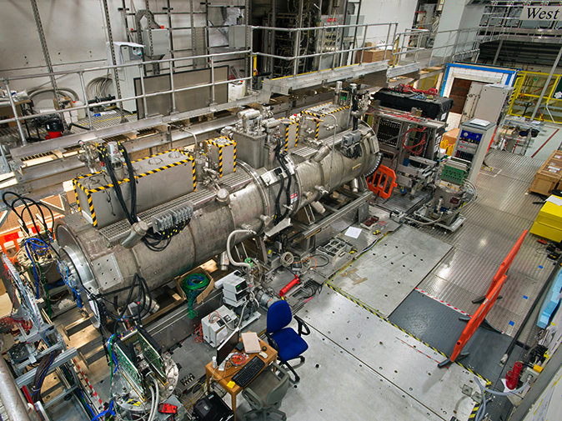
MICE Step IV

Slide 8
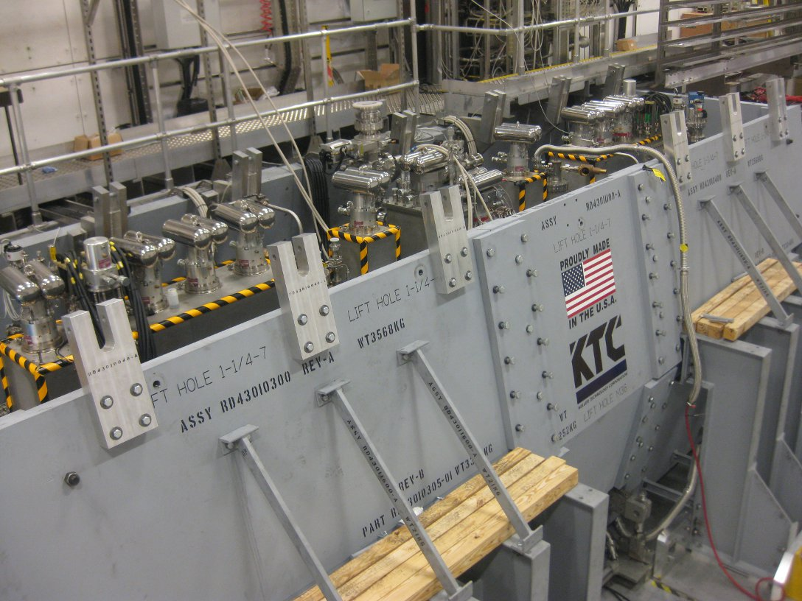
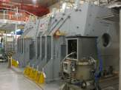
Partial Return Yoke (PRY)
Flux return path to protect sensitive equipment from fringe field of magnet chain.
100mm thick soft iron plate
2 angled plates per side, each fabricated from 3 sections
End plates made in 2 sections
Bracing structures
Made in the USA
Support structure made in UK
Shipped to UK and installed to schedule
5 Gauss perimeter now runs just outside PRY supports.
stray field concerns in critical areas eliminated

Slide 9
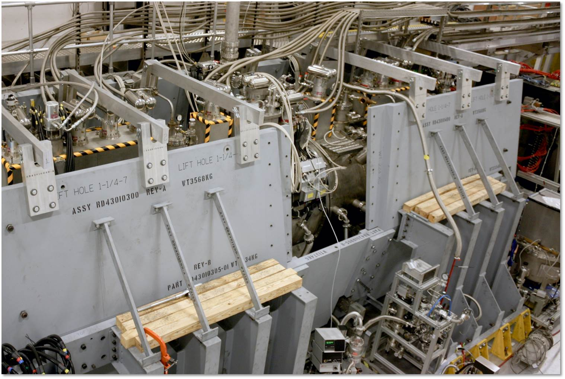
Partial Return Yoke (PRY)

Slide 10
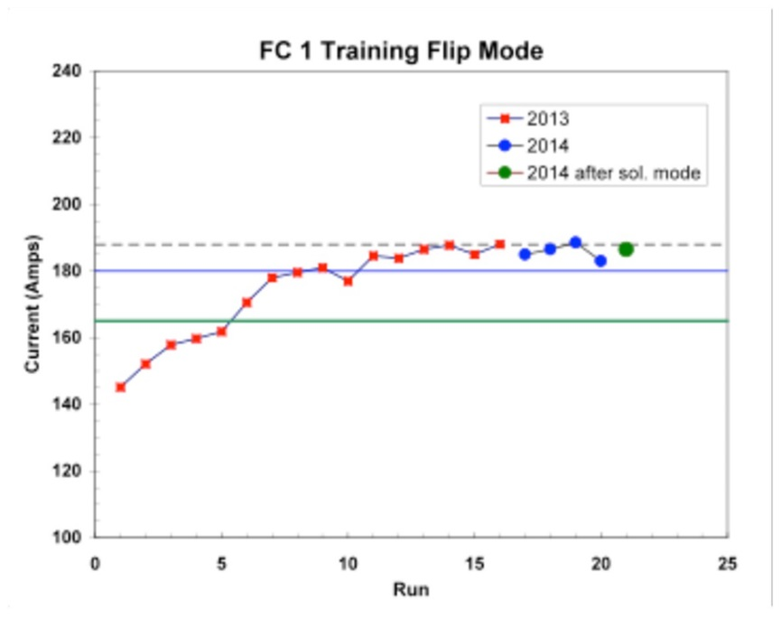
Step IV: Magnets
2 spectrometer solenoids with matching coils
Fabricated in US
Trained successfully to operating current
10-20 quenches each, training not retained after warming.
Field mapped.
Shipped to UK
On translation stages in hall
Compressors installed plumbed, wired and connected
Successful cool-down
Independent training in progress.
2 Focus coils (only one required in current configuration)
Constructed in UK
Trained to operating current
Installed in hall

Slide 11
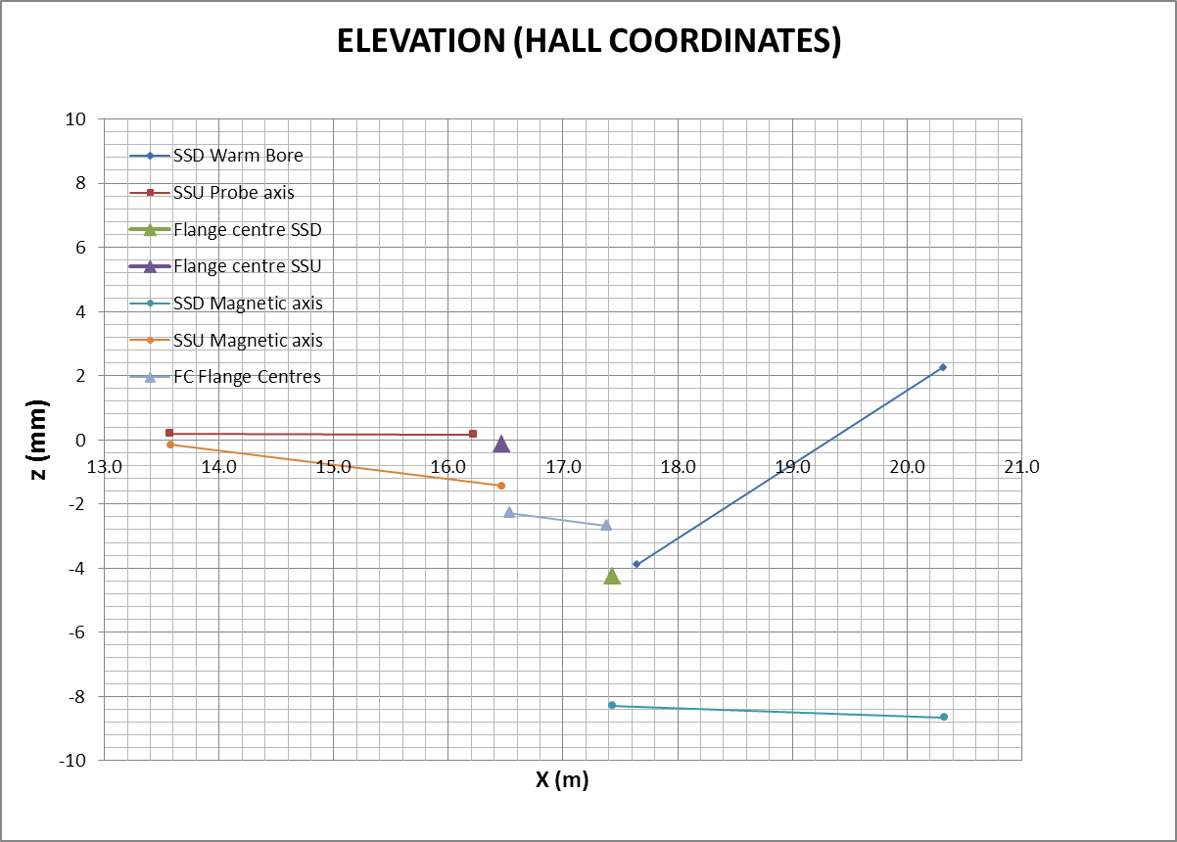
Magnetic Alignment
Spectrometer solenoids and Focus coil connected with hydro-formed bellows
Measured offsets between warm bores and magnetic field at manufacture.
Hydro-formed bellows are relatively ‘stiff’ and allow angular but not axial offset
Correct with bespoke offset bellows
Quench forces must be considered.

Slide 12
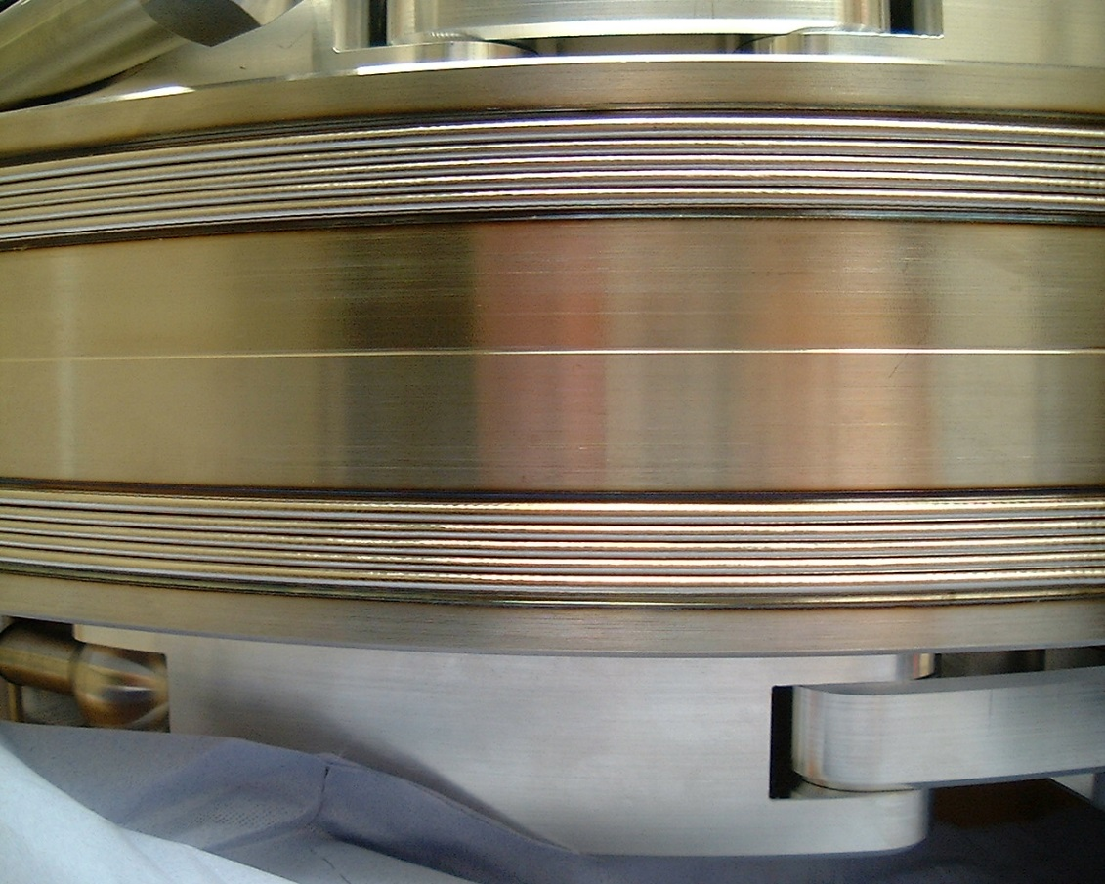
Bellows
692.15mm OD x 539.75mm ID nested bellows : Extended length 66mm Closed length 14mm Stroke 52mm nom free length 40mm Axial stiffness 200N/mm. 316L, 0.91mm thk. End terminals: 316.

Slide 13
Cold Heads and Compressors
Each Spectrometer solenoid has 5 cold heads
1 compressor per cold head
Compressors installed 30m distant on ‘West Wall’
Conventional specification; max hose length = 20m
30m hoses produce insignificant losses for SS
Focus Coil, 2 cold heads
1 Compressor per cold head
Possible reduced cooling margin seen
Compressors moved close on ‘South Mezzanine’

Slide 14
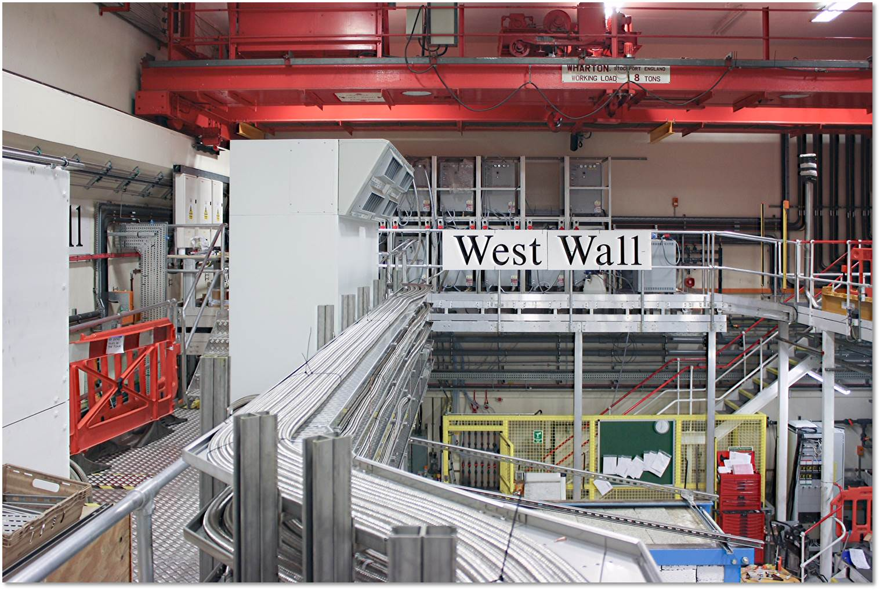
He compressors and lines

Slide 15
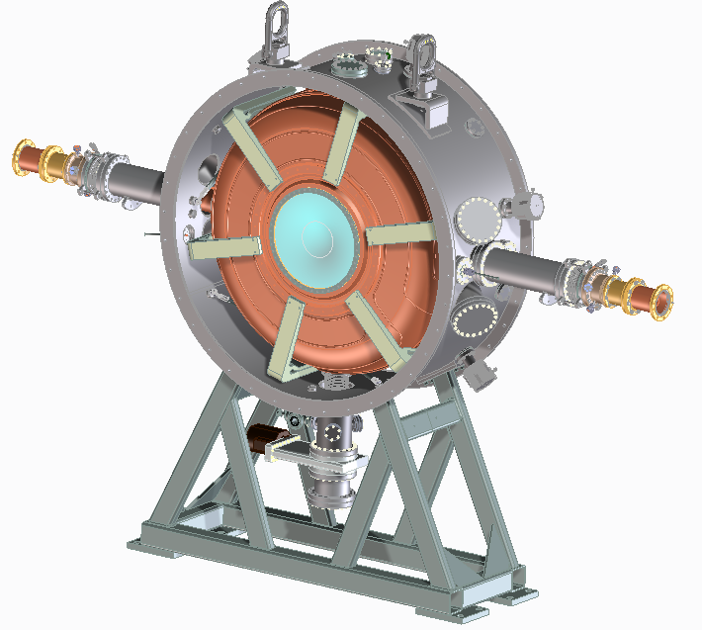
Cooling: RF Modules
2 RF modules
One RF cavity, two Be windows two RF power couplers
One vacuum vessel, common with absorbers
Six tuner arms and six actuators
Cavity support struts
Vacuum pump system and water cooling
Diagnostics and bypass lines

Slide 16
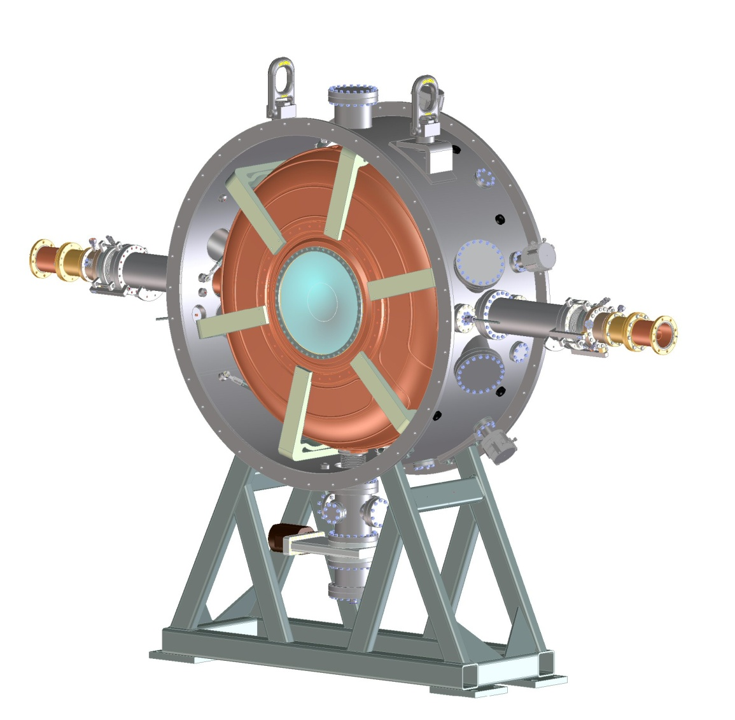
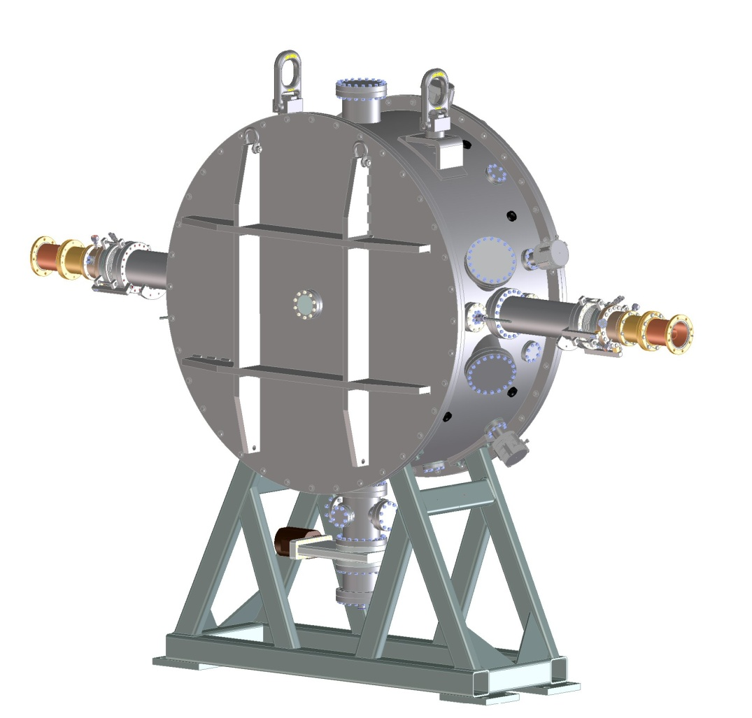
RF Module
Designed/fabricated LBNL. Electropolished, plated couplers
Tested to 14MV/m in magnetic field at FNAL (10.2MV/m required)
Tuning via air actuators demonstrated at high power with recovery.

Slide 17
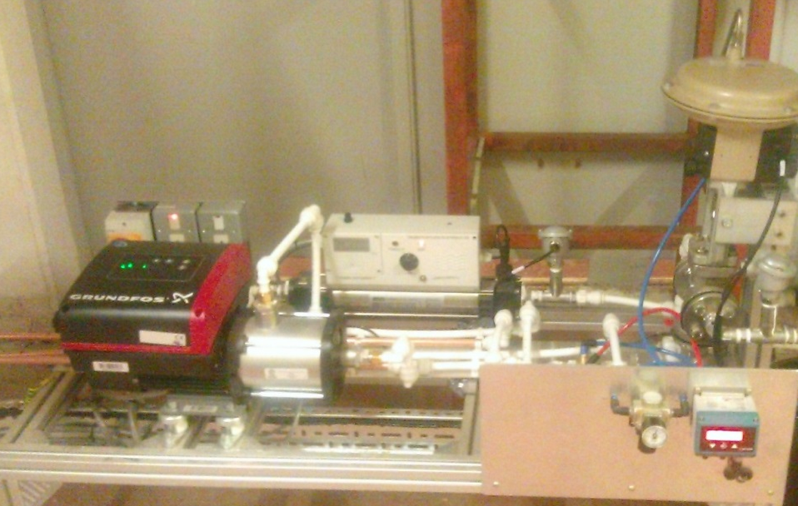
Cavity Temperature
Cavity on frequency at 36.5 degrees
water cooling system with heater, cold water and mixing valve control by high resolution process controller that self learns
Water flow rates on cavity are restricted due to small cooling pipes
0.05 degrees cavity temperature stability achieved
RF trips result in cavity detuning which can take 5 minutes for recovery
RF is always applied at effectively maximum

Slide 18
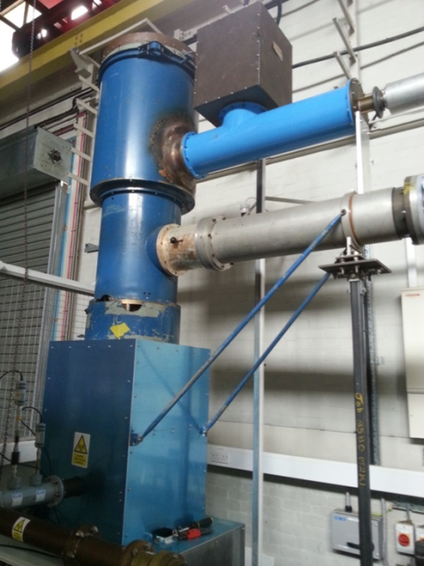
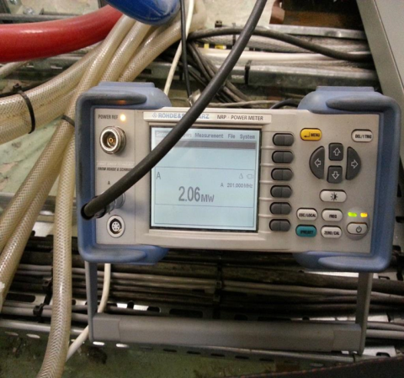
HPRF System Status
MICE RF systems demonstrated
Nominal power levels 2MW, Frequency (201.25MHz) for 1ms @ 1Hz
First amplifier tested in MICE hall
Triode amplifier (output stage) remains installed
Tetrode and all modulator racks shipped to Daresbury
New higher voltage solid state crowbar tested
Triode 2 will be tested using No. 1 tetrode and modulators
Will use upgraded Triode No.1 modulator
Each major No. 1 subsystem will be swapped for No. 2 sequentially
Fault finding more rapid
Remote control philosophy in developement
Will be tested during commissioning of No. 2 system

Slide 19
HPF Re-baseline changes
Certain risk and procurement items have been eliminated or mitigated
Distribution network simplified
9 cavities available (2 needed)
4 off Thales 116 Triode valves available (2 required)
2 spare sets of valve amplifier assemblies readily available
MICE & ISIS RF Subsystem: Synergies and Interaction
Strong correlations between MICE and ISIS Linac RF systems
MICE RF Engineer has requested to participate in ISIS Linac commissioning
ISIS Linac RF amplifier test station similar to MICE amplifier installations
MICE RF Team working with ISIS Linac RF Team on LLRF systems
ISIS Linac control philosophy used as model for MICE RF
MICE RF system safety under MICE-ISIS Safety committee

Slide 20
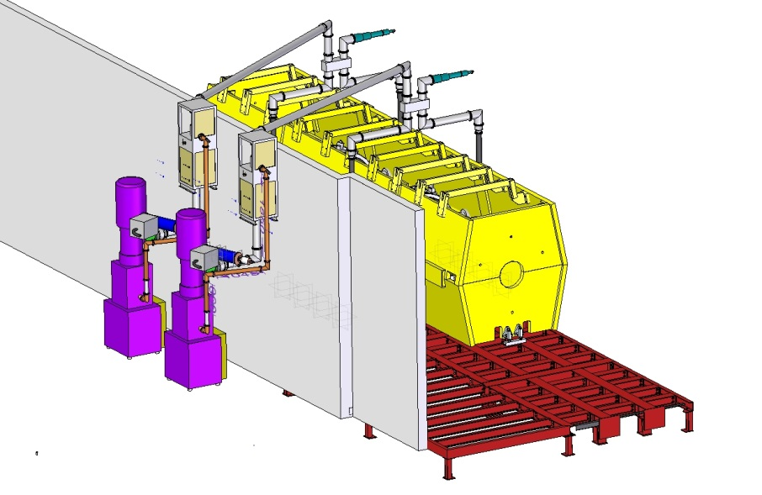
RF Power distribution
RF power transmission overhead
SF₆ filled co-axial lines
Relatively easily de-mountable
Independent vacuum system for cavities

Slide 21
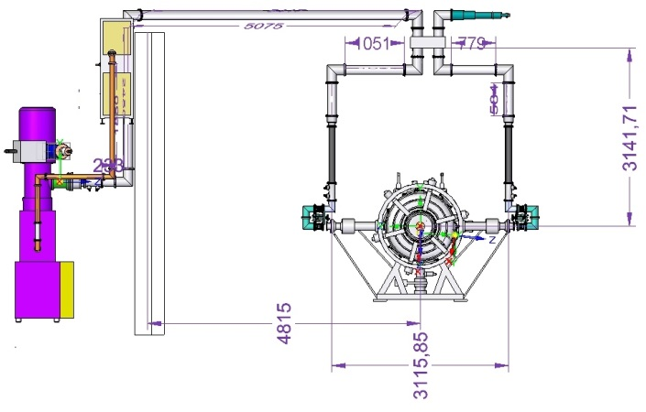
RF Power
Simplified distribution network- overhead
Off-centre mounting of hybrid takes up phase shift
Minimised length of 4” line- minimises losses
500kW Load
4616 Pre Amplifier
Directional
Coupler in
each line
Hybrid Splitter
Flexible coax
Directional
Coupler 6 inch
Line Trimmers
TH116
Amplifier

Slide 22
Cooling Demonstration
Muon Ionisation Cooling Experiment.
Demonstrate that the emittance of a muon beam can be reduced, the muon beam can be “cooled”
Superconducting magnet ‘string’. Partial return yoke
LiH absorber.
2 normal conducting RF cavities with Be windows.
2 high power RF amplifier chains.
MICE will deliver the necessary, seminal, demonstration of ionisation cooling required for future experiments.

