Slide 1
QXF Coil Fabrication: A Forward Look
Joint LARP CM20/HiLUMI Collaboration Meeting
April 8-10, 2013 • Napa, CA USA
Dan Cheng
April 9, 2013

Slide 2
Outline
Overview
Standing Issues in Coil Fabrication
Summary

Slide 3
The LARP QXF Coil Task: At a Glance
FNAL
LBNL/BNL
CERN

Slide 4
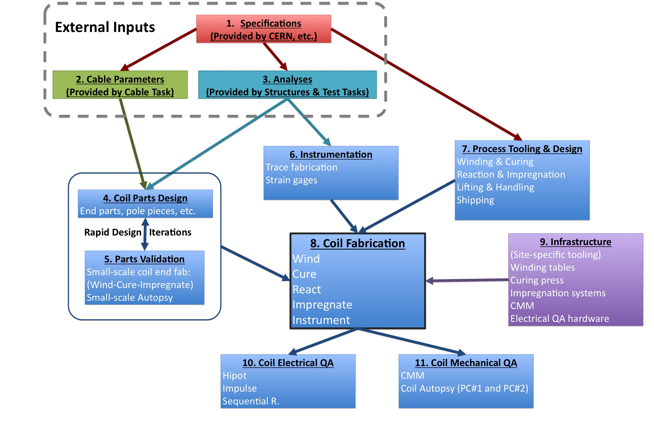
The LARP QXF Coil Task: A Second Look

Slide 5
Background to QXF Coil Fabrication Issues
Fabrication review of HQ/LHQ coils was held in March 2013; recommendations given
Fabrication of future coils were covered in talks by M. Yu and F. Borgnolutti
QXF Coil fabrication
HQ/LHQ coil fabrication experiences provide a basis for QXF coil fabrication processes
But some outstanding issues remain to be addressed

Slide 6
Qxf coil fabrication: standing Issues

Slide 7
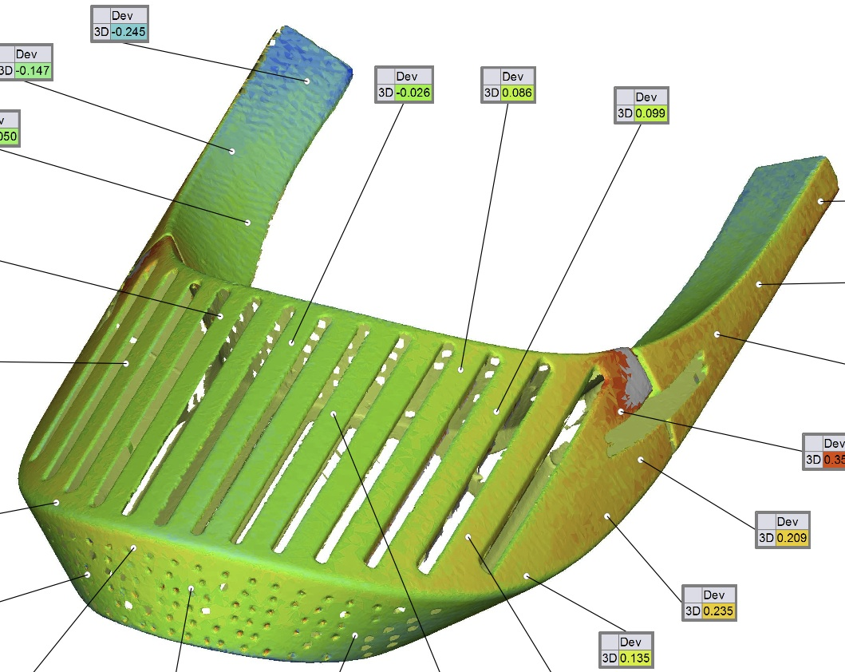
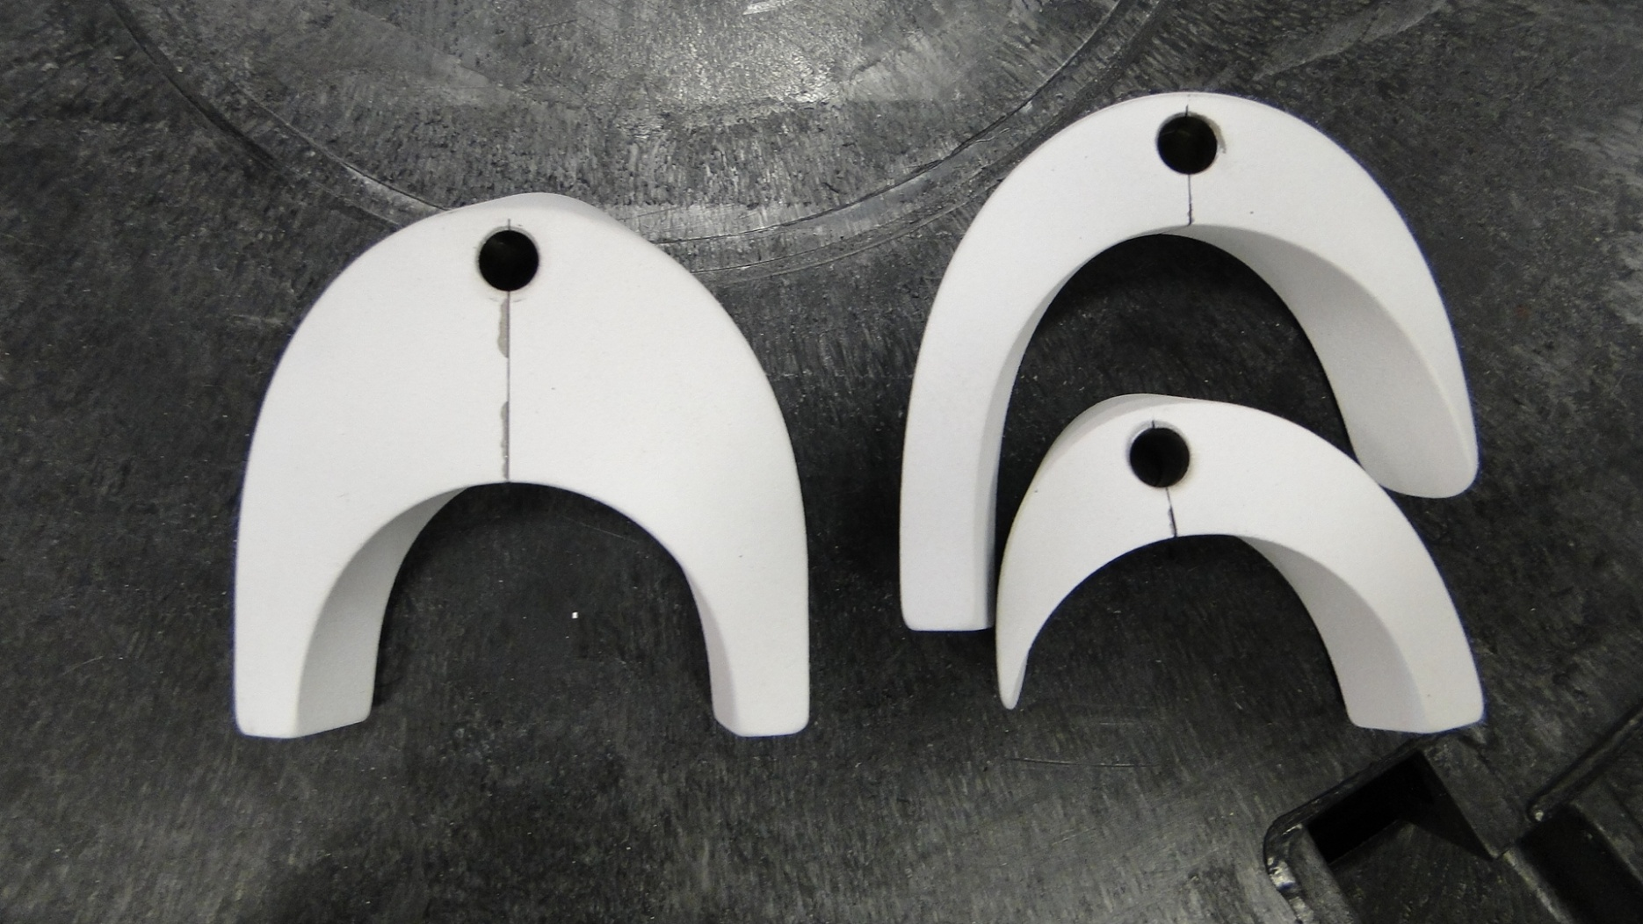
Coil Parts & Design
Rapid design iterations are necessary
Parts design
Rapid prototype fabrication (DMLS, FDM, etc.) for quick turnaround
Test fit spacers, end saddles, etc. using coil winding tests (this is different from cable windability tests)
Measure and CMM modified parts
Apply fit feedback to the analytical (Roxie/Bend) models of coil shapes for final designs
Plasma sprayed parts
Issues of durability and repeatability on surfaces where deemed useful (and/or necessary)
Coil alignment keys
Question of Titanium or G11 still must be examined
Design
Fit
Fab.
Courtesy: G. Kirby

Slide 8
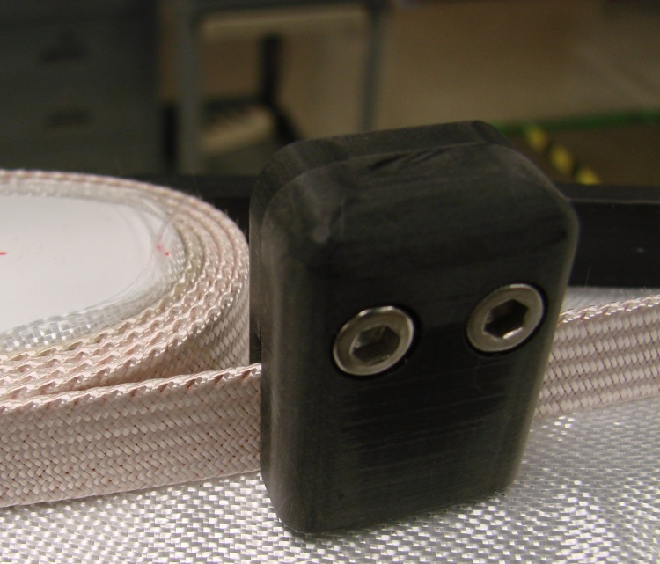
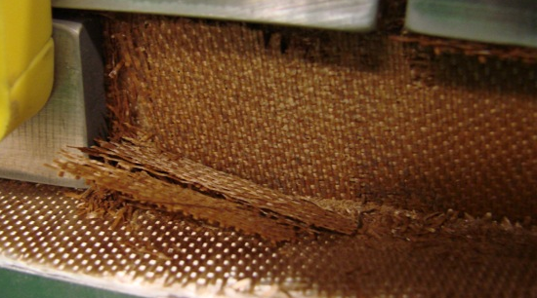
Coil Processing: Winding
Popped strands during winding
What is the most effective method of prevention and/or repair?
Winding tool, curing matrix, or…?
Winding tension & cable twist
Fixed tension, or dynamic tension during turns
Coil winding infrastructure may be unable to introduce cable twist
Intralayer insulation layers
Cured glass fabrics exhibit brittle behavior after reaction—leave layer uncured or cured?
Coil packaging and clamping (see curing issues in next slide)
Cured S-glass in HD3 Coil 1
Crumbled after reaction

Slide 9
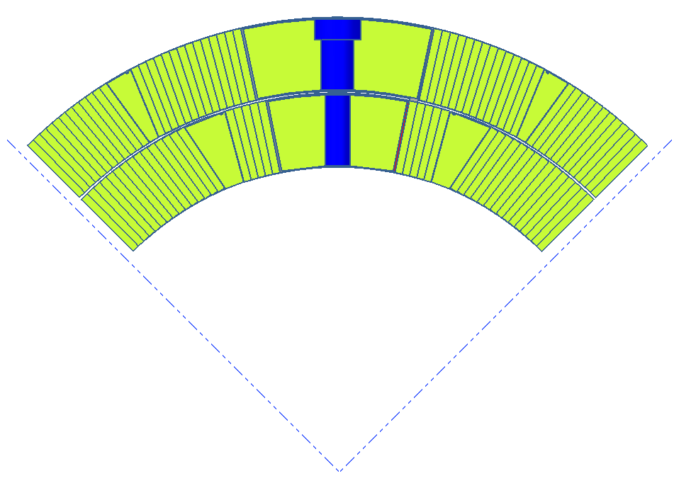
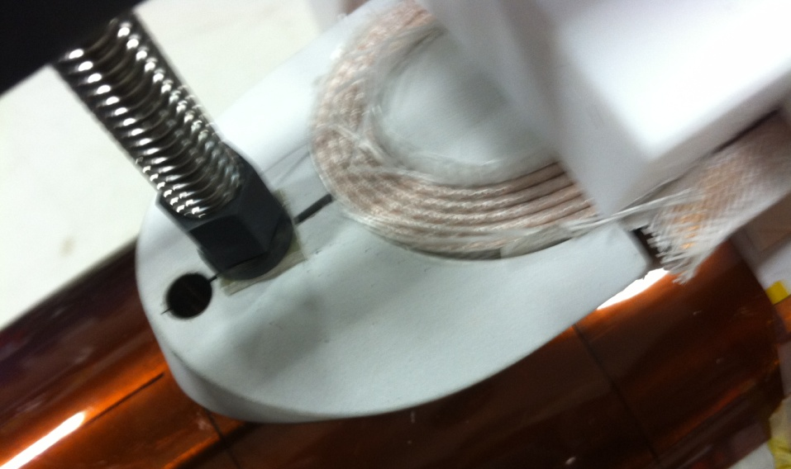
Coil Processing: Curing
Curing operations
Not all infrastructure supports applying separate mandrel and platen operations
The addition of extra shims on midplane:
Does overcompressing the coil at the midplane during curing affect the final coil package size in any appreciable way?
What are the risks/rewards of doing this?
Final parts fit
Historically, many spacers, endshoes did not fit after winding--required curing operation for correct fit
Use replaceable “curing” endshoes? (Does not apply to spacers) Or, improve winding processes to keep layers compressed?
Can the curing operation be eliminated entirely in QXF coil fabrication with redesigned tooling?

Slide 10
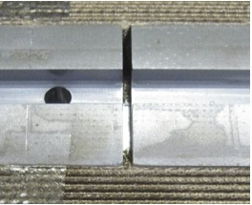
Coil Processing: Reaction
Gaps
Pole islands, wedges optimization
HQ Coils 17 and 21 did not close gaps after reaction
All other coils used insulation sleeve
Seems to indicate that directly braided insulation on cables needs more data
Practice QXF coil(s) should be designed so that gaps remain in the islands after reaction
Mica slip planes
Can two coils be reacted effectively in one oven cycle?
HQ Coil 17
post-reaction pole gap

Slide 11
Coil Processing: Impregnation
Does CTD 101K epoxy exhibit acceptable radiation hardness?
What are the requirements?
What is the real data?
Technical challenges for impregnation using Cyanate Ester blends (or other materials) must be overcome for long coils
Instrumentation traces
Do laminated polyimide trace materials pose problems for impregnation?
Trace behavior (bubbles) on inside bore after testing cycle have continued
Inside bore of HQ02a during
assembly (Coil 15 was previously
tested in HQ mirror)
Bubbles on inside bore of
LQS03 after magnet test

Slide 12
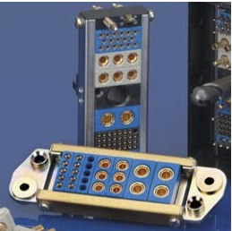
Coil Processing: Instrumentation
Strain gages
Bonding, protection of SGs
Instrumentation/heater traces
Are thicker (>25 µm) polyimide layers acceptable for quench protection? (HQ02a results pending)
Wiring
Most Teflon insulated instrumentation wires (VT & SGs) currently used are rated for 600V; what is acceptable for high voltage performance (~5kV coil hipot testing)?
Can the packaging of instrumentation wires be optimized in magnet assemblies for axial loading
Connectors
Plain Hypertronics connectors are not polarized—easy to flip connectors
Manuf. stated specs say ~1600V – 3000V breakdown voltage (<5kV hipot testing)
Instrumentation wire routing
of LQS03 at Lead End.

Slide 13
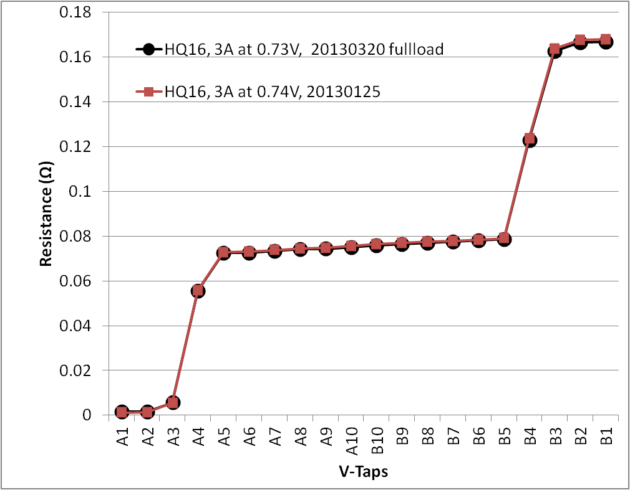
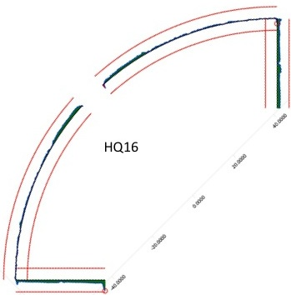
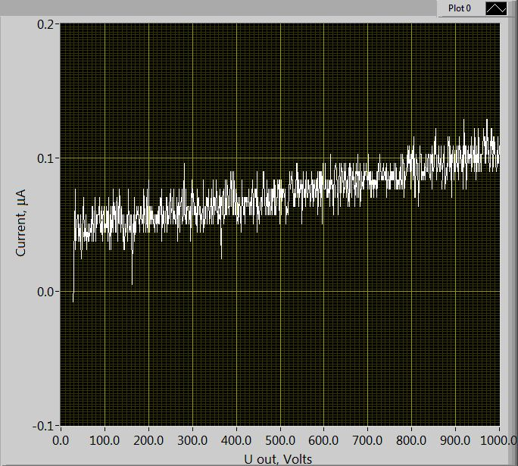
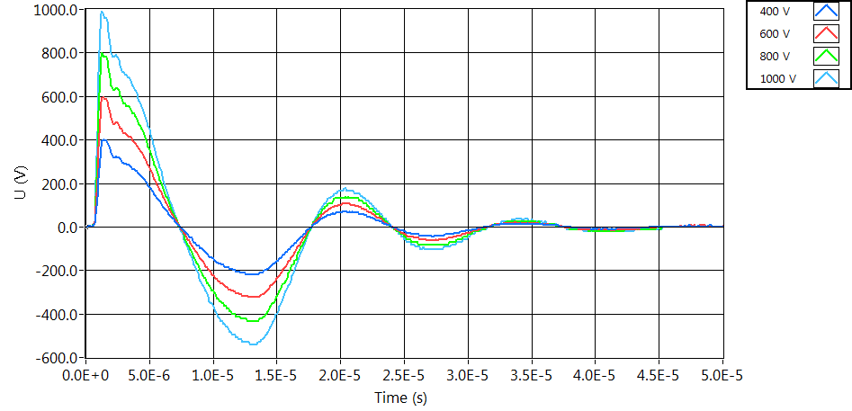
Coil Processing: Inspection & Electrical QA
Determine what QA steps are necessary throughout all process steps to sufficiently document behaviors
Mechanical inspections
CMM
All Labs to use same reference models
Develop database of pre- and post-compression measurement data for coils
Coil Autopsies (for practice coils and other)
Develop a clear definition of what features, interfaces, profiles need to be inspected and how this feeds back into real coil production
Electrical QA
Is it beneficial to use the same hardware systems and software for QA steps (impulse, hipot, Sequential R tests) at different Labs?

Slide 14
Open Issues Summary
The QXF coil task has standing issues and/or technical decisions that need to be made through all stages of design and fabrication
Some experimental data exists, but we need more data points to make technically sound decisions
We may be able to leverage pre-existing tasks efficiently in order to solve many of these issues
HQ, LHQ, and Base Programs (GARD) may already be positioned to answer some of these

Slide 15
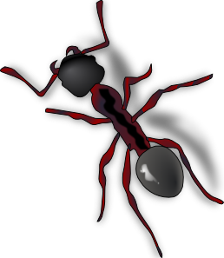
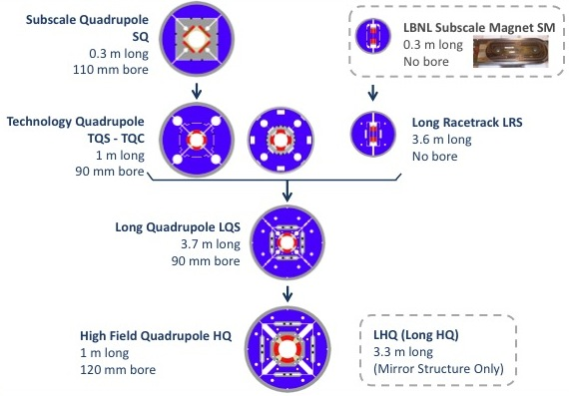
QXF Coils: Begin with the end in mind…
Primary outcome of LARP (and QXF Coil Fabrication) should be Documentation
Of Designs
Of Processes
Of Performance and Behaviors
…independent of infrastructure and/or Laboratories
Our experience with QXF coil fabrication as a “pre-prototype” must provide a solid foundation for the prototype and the production IR quads that follow
Develop processes and procedures now to begin addressing increased uniformity, throughput, and yield in coil fabrication
IR Quad Production
IR Quad Prototype
QXF
Family Tree of LARP model magnets

Slide 16
Appendix

Slide 17
The LARP QXF Coil Task: External Inputs

