Slide 1
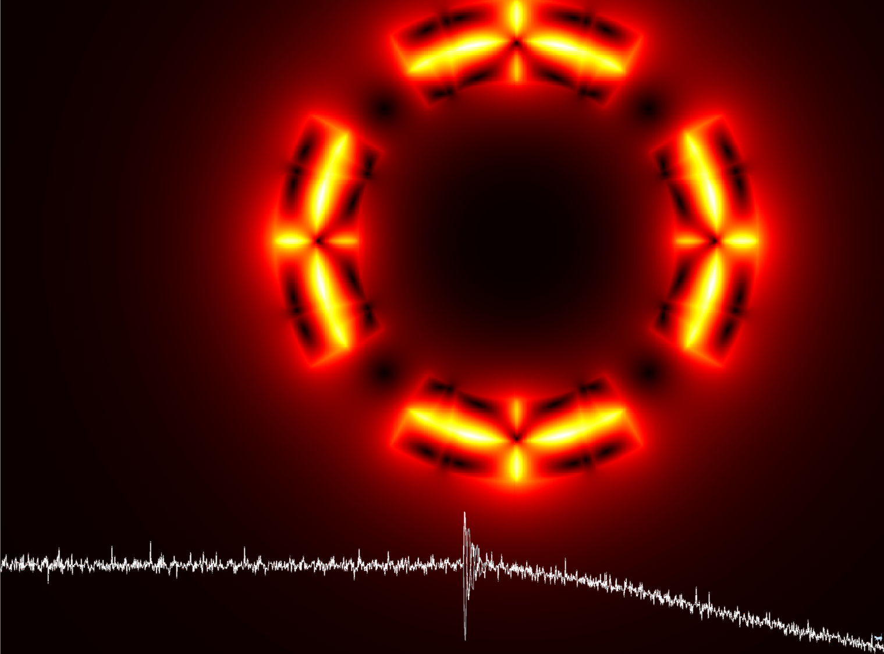
CLIQ tests on SQXF at FNAL
Emmanuele Ravaioli
LARP Collaboration Meeting
13 May 2015

Slide 2
CLIQ tests on SQXF at FNAL
Main objective
Assessing the performance of a CLIQ-based protection system in conditions closest possible to the full-size case.
Goals
Test CLIQ performance -Different at low and high current
Verify correct choice of the optimum configuration
Compare performance 1-CLIQ vs 2-CLIQ
Further validate existing model of a CLIQ discharge
Emmanuele Ravaioli - CLIQ tests on SQXF at FNAL LARP Collaboration Meeting - 13 May 2015

Slide 3
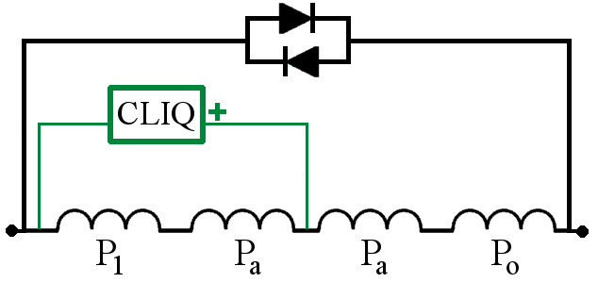
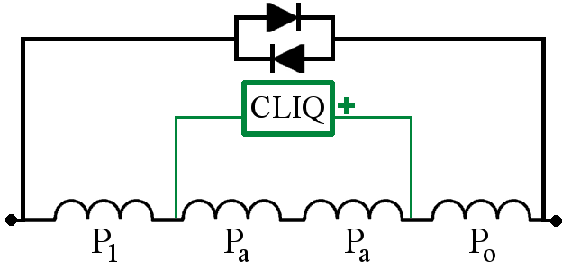
Optimum CLIQ discharge configuration
Not Optimized
Optimized
–
–
+
+
+
–
–
+
Significant increase of CLIQ effectiveness (2.5-3 times)
Significant reduction of Leq (2.5-3 times)
→ Increase of deposited loss (6-9 times!)
→ Increase of oscillation frequency (1.5-2 times)
Emmanuele Ravaioli - CLIQ tests on SQXF at FNAL LARP Collaboration Meeting - 13 May 2015

Slide 4
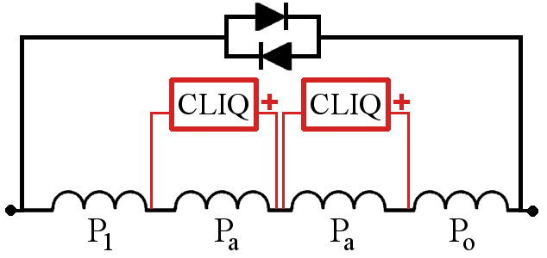
1-CLIQ or 2-CLIQ
1-CLIQ
2-CLIQ
Parameter | 1 CLIQ | 1 CLIQ 2xU₀ | 1-CLIQ, 2xU₀, C/2 | 2 CLIQ
Equivalent inductance, L_{eq} | L_{eq} | = | = | ÷4
Total capacitance, C_{eq} | C | = | = | x2
Charging voltage, U₀ | U₀ | x2 | x2 | =
Peak current change, dI/dt | U₀/L_{eq}/N_{E} | x2 | x2 | x2
Peak deposited loss | ∞(U₀/L_{eq}/N_{E})^2 | x4 | x4 | x4
Peak AC current, I | ∞U₀*sqrt(C_{eq}/L_{eq})/N_{E} | x2 | x2^{0.5} | x2^{0.5}
Frequency, f | 1/2/π/sqrt(L_{eq}*C_{eq}) | = | x2^{0.5} | x2^{0.5}
Same performance
Emmanuele Ravaioli - CLIQ tests on SQXF at FNAL LARP Collaboration Meeting - 13 May 2015

Slide 5
Scaling of CLIQ performance
At high current
Low energy needed to start the quench
High energy density, needs to be quick!
→ POWER is the key parameter
CLIQ effectiveness
→ Coil geometry
→ Position of CLIQ connections
→ Electrical order of the poles
→ Conductor parameters
→ etc…
(Number of CLIQ units)^2
(Charging voltage)^2
(magnetic length)^-2 (fixed by design)
At low current
High energy needed to start the quench
Low energy density, velocity not critical
→ ENERGY is the key parameter
Number of CLIQ units
(Charging voltage)^2
Capacitance of each unit
(magnetic length)^-1
Magnetic length
# of CLIQ units
Capacitance
E. Ravaioli - TE-MPE-TM 15 April 2015

Slide 6
How to choose the settings of the CLIQ system?
New CLIQ units: C=40 or 80 mF, U0=50-500 V
CLIQ units for 7 m MQXF: C=30 mF, U0=1000 V
Name | Magnet length [m] | Configuration | NC | C [mF] | U0 [V] | E [kJ] | E/length wrt baseline | Pif/vol wrt baseline | ∞f wrt baseline
Baseline 1-CLIQ | 7.15 | Pole-Pole | 1 | 30 | 1000 | 15.0 | 2.1 | 19561 | 0.3
Baseline 2-CLIQ | 7.15 | Pole-Pole | 2 | 60 | 500 | 15.0 | 2.1 | 19561 | 0.2
SQXF-PP-1C-01 | 1.5 | Pole-Pole | 1 | 80 | 500 | 10.0 | 3.2 | 5.7 | 1.3
SQXF-PP-1C-02 | 1.5 | Pole-Pole | 1 | 80 | 210 | 1.8 | 0.6 | 1.0 | 1.3
SQXF-PP-1C-03 | 1.5 | Pole-Pole | 1 | 80 | 280 | 3.1 | 1.0 | 1.8 | 1.3
SQXF-PP-1C-04 | 1.5 | Pole-Pole | 1 | 40 | 500 | 5.0 | 1.6 | 5.7 | 1.9
SQXF-PP-1C-05 | 1.5 | Pole-Pole | 1 | 40 | 210 | 0.9 | 0.3 | 1.0 | 1.9
SQXF-PP-1C-06 | 1.5 | Pole-Pole | 1 | 40 | 397 | 3.1 | 1.0 | 3.6 | 1.9
SQXF-PP-2C-01 | 1.5 | Pole-Pole | 2 | 80 | 500 | 20.0 | 6.4 | 22.7 | 1.9
SQXF-PP-2C-02 | 1.5 | Pole-Pole | 2 | 80 | 105 | 0.9 | 0.3 | 1.0 | 1.9
SQXF-PP-2C-03 | 1.5 | Pole-Pole | 2 | 80 | 198 | 3.1 | 1.0 | 3.6 | 1.9
SQXF-PP-2C-04 | 1.5 | Pole-Pole | 2 | 40 | 500 | 10.0 | 3.2 | 22.7 | 2.7
SQXF-PP-2C-05 | 1.5 | Pole-Pole | 2 | 40 | 105 | 0.4 | 0.1 | 1.0 | 2.7
SQXF-PP-2C-06 | 1.5 | Pole-Pole | 2 | 40 | 280 | 3.1 | 1.0 | 7.2 | 2.7
SQXF-ULP-1C-01 | 1.5 | Up-Low-Pole | 1 | 80 | 500 | 10.0 | 3.2 | not optimized | not optimized
SQXF-ULP-1C-02 | 1.5 | Up-Low-Pole | 1 | 40 | 500 | 5.0 | 1.6 | not optimized | not optimized
SQXF-ULP-1C-01 | 1.5 | Up-Low-Pole | 2 | 80 | 500 | 20.0 | 6.4 | not optimized | not optimized
SQXF-ULP-1C-02 | 1.5 | Up-Low-Pole | 2 | 40 | 500 | 10.0 | 3.2 | not optimized | not optimized

Slide 7
Wish list (7 full sweeps, 5 low-current sweeps, ~50 tests)
Config | #units | U0 [V] | C [mF] | I0 [A] | Motivation
Opt | 1 | 200 | 80 | Full sweep* | Same peak power of MQXF-7m
Opt | 1 | 200 | 40 | Full sweep* | Useful for model validation
Opt | 1 | 100 | 80 | Full sweep* | Same peak power of MQXF-4m
Opt | 1 | 100 | 40 | Full sweep* | Useful for model validation
Opt | 1 | 300 | 80 | Low sweep** | Same energy density of MQXF-7m
Opt | 1 | 400 | 40 | Low sweep** | Same energy density of MQXF-7m
Opt | 1 | 200 | 80 | Low sweep** | Same energy density of MQXF-4m
Opt | 1 | 300 | 40 | Low sweep** | Same energy density of MQXF-4m
Opt | 1 | 500 | 80 | Full sweep* | Ultimate performance
Not-Opt | 1 | 500 | 80 | Full sweep* | Study of not optimized config, model validation
Opt | 2 | 100 | 80 | Full sweep* | Same peak power of MQXF-7m, 2-CLIQ option
Opt | 2 | 200 | 80 | Low sweep** | Same energy density of MQXF-7m, 2-CLIQ option
*Full sweep: from about 2 kA to ultimate, in 5 steps; **Low swep: two low current levels (2 and 5 kA?)

Slide 8
Simulations – CLIQ on 1.5 meter long QXF magnet – 500 V
2-CLIQ, 2x80 mF, 500 V
1-CLIQ, 1x80 mF, 500 V

Slide 9
What is the best option for effective CLIQ tests?
Goals: Obtaining meaningful data while still assuring redundancy of the protection during the tests in the case of CLIQ misfiring (fully redundant CLIQ possible, but not during these tests; modifications to the unit design is under study)
Option 1: EE delayed
Pros: The resistance growth in the coil is only due to CLIQ (but quench-back is still present)
Cons: (especially at low current) the discharge is dominated by the EE; interaction between CLIQ and EE to be carefully considered
Option 2: IL QH delayed
Pros: Cleaner currents to analyze; in the outer layer, relatively easy to assess CLIQ performance
Cons: Maybe not very clear if the inner layers are quenched by CLIQ or QH
Option 3: IL+OL QH of only two poles (ideally OL QH of two poles, safe?)
Pros: Cleaner currents to analyze; direct comparison between performance of CLIQ and CLIQ+QH (partly biased since the current discharge is faster than with CLIQ only)
Cons: Careful study of the voltages to ground needed (asymmetric quench).
Emmanuele Ravaioli - CLIQ tests on SQXF at FNAL LARP Collaboration Meeting - 13 May 2015

Slide 10
Integration of new CLIQ units at FNAL test facility
2 CLIQ units are being manufactured at CERN specifically for these tests; they will be ready at the end of May/beginning of June (tests at CERN needed before shipping to the US)
A few issues to discuss (off-line)
Reverse diode string across the power supply
Reverse diode string across the energy-extraction system
Connections
Triggering signals
Emmanuele Ravaioli - CLIQ tests on SQXF at FNAL LARP Collaboration Meeting - 13 May 2015

Slide 11
Annex
Emmanuele Ravaioli - CLIQ tests on SQXF at FNAL LARP Collaboration Meeting - 13 May 2015

Slide 12
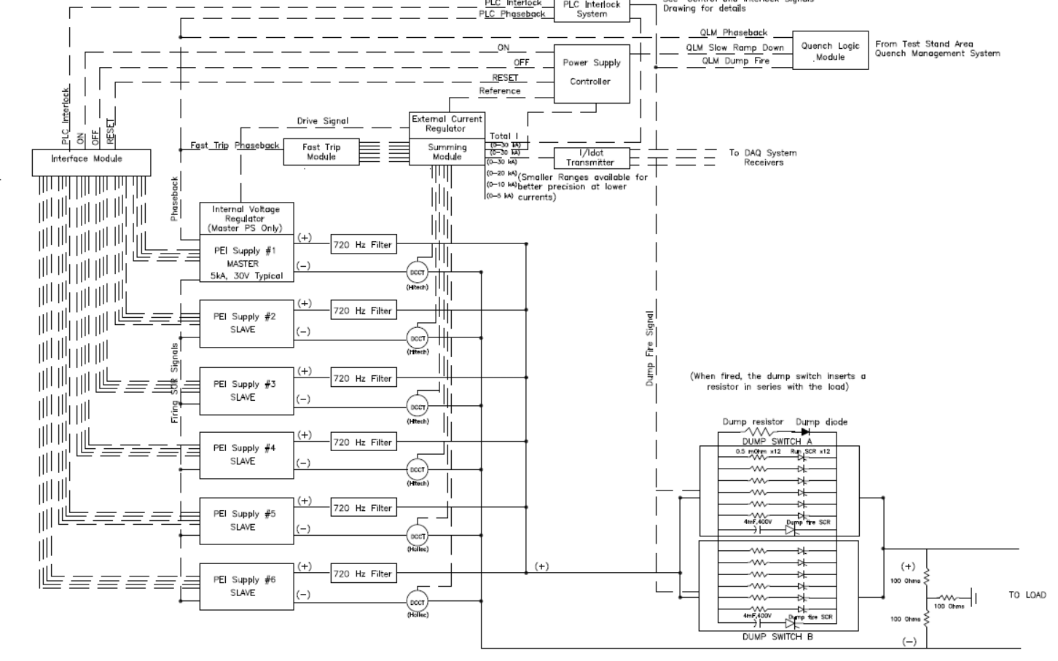
Circuit diagram of FNAL test station
Emmanuele Ravaioli - CLIQ tests on SQXF at FNAL LARP Collaboration Meeting - 13 May 2015

Slide 13
CLIQ units for FermiLab – Main functional requirements
Main Funcional requirements | MQXF l=1.2 m | MQXF l=4.0 m | MQXF l=6.8 m
Maximum charging voltage [V] | 500 | 500 | 500
Capacitance [mF] | 80 | 80 | 80
Maximum stored energy [kJ] | 10 | 10 | 10
Internal resistance [mOhm] | <5 | <5 | <5
Max triggering delay [ms] | 1 | 1 | 1
Triggering delay (preferred) [ms] | 0.2 | 0.2 | 0.2
Expected peak current [kA] | 6.6 | 3 | 2.5
Expected frequency [Hz] | 30-50 | 15-25 | 10-20
Time before fully discharge unit [ms] | 50 | 100 | 200

Slide 14
1-CLIQ or 2-CLIQ
1-CLIQ
2-CLIQ
Very similar performance expected, but 1-CLIQ:
More reliable (less components)
Avoid synchronization problems
Reduce the impact of various fault scenarios
Gives the same peak voltage to ground
Emmanuele Ravaioli - CLIQ tests on SQXF at FNAL LARP Collaboration Meeting - 13 May 2015

Slide 15
Current Change
CLIQ – Coupling-Loss Induced Quench protection system
Magnetic Field Change
Coupling Losses (Heat)
Temperature Rise
QUENCH
Patent EP13174323.9
Emmanuele Ravaioli - CLIQ tests on SQXF at FNAL LARP Collaboration Meeting - 13 May 2015

Slide 16
Summary of CLIQ and QH performance on the model magnet
At nominal current quench load reduced by ~30% using CLIQ
However, CLIQ performance strongly depends on the magnet length
Emmanuele Ravaioli - CLIQ tests on SQXF at FNAL LARP Collaboration Meeting - 13 May 2015

Slide 17
CLIQ – Typical discharge
Excellent agreement between simulations and measurements
Emmanuele Ravaioli - CLIQ tests on SQXF at FNAL LARP Collaboration Meeting - 13 May 2015

Slide 18
Testing CLIQ – Nb₃Sn model magnet for HL-LHC (HQ02b)
First CLIQ tests on a Nb₃Sn magnet
Emmanuele Ravaioli - CLIQ tests on SQXF at FNAL LARP Collaboration Meeting - 13 May 2015

Slide 19
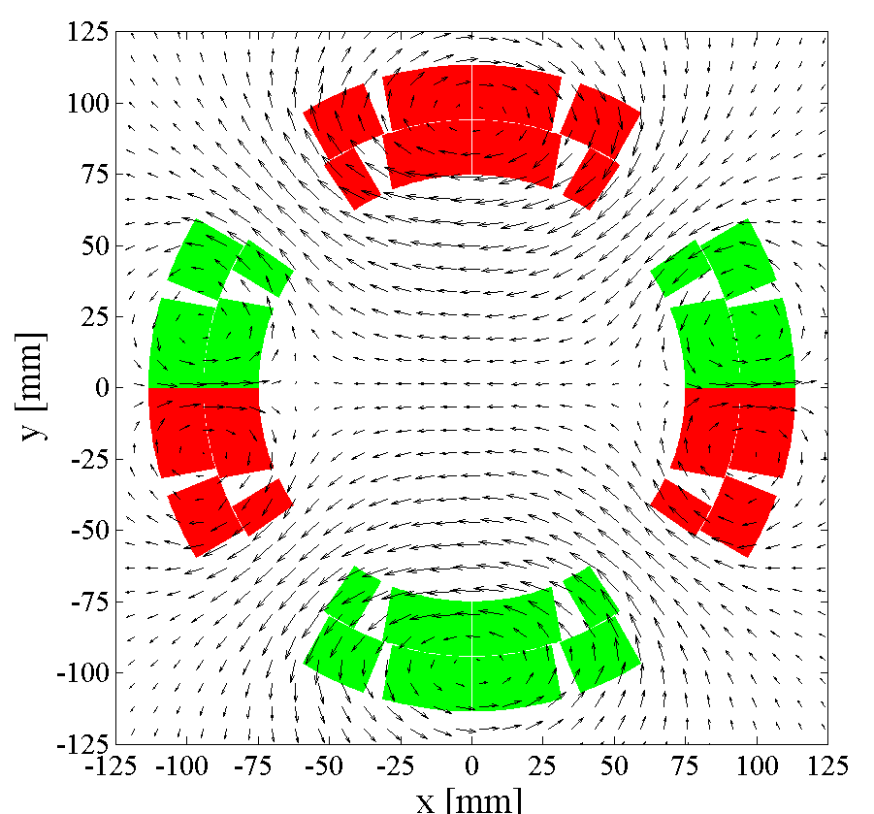
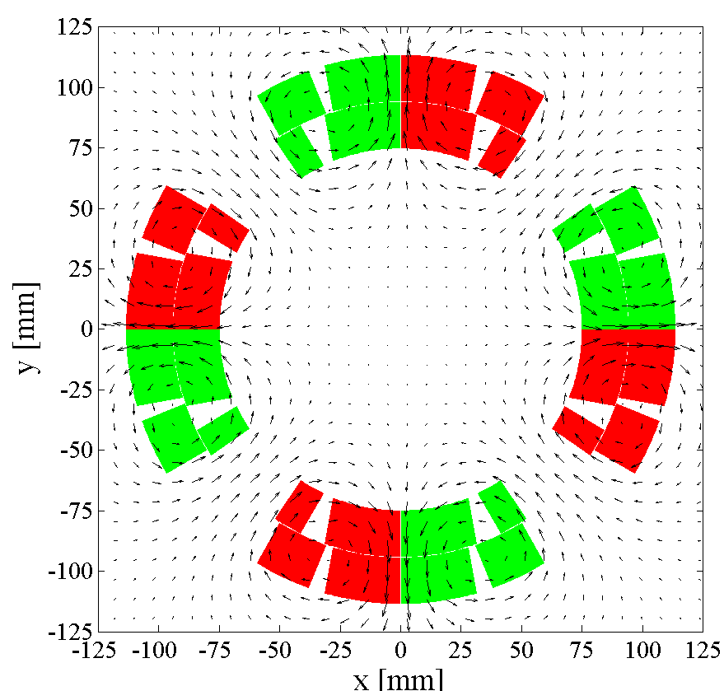
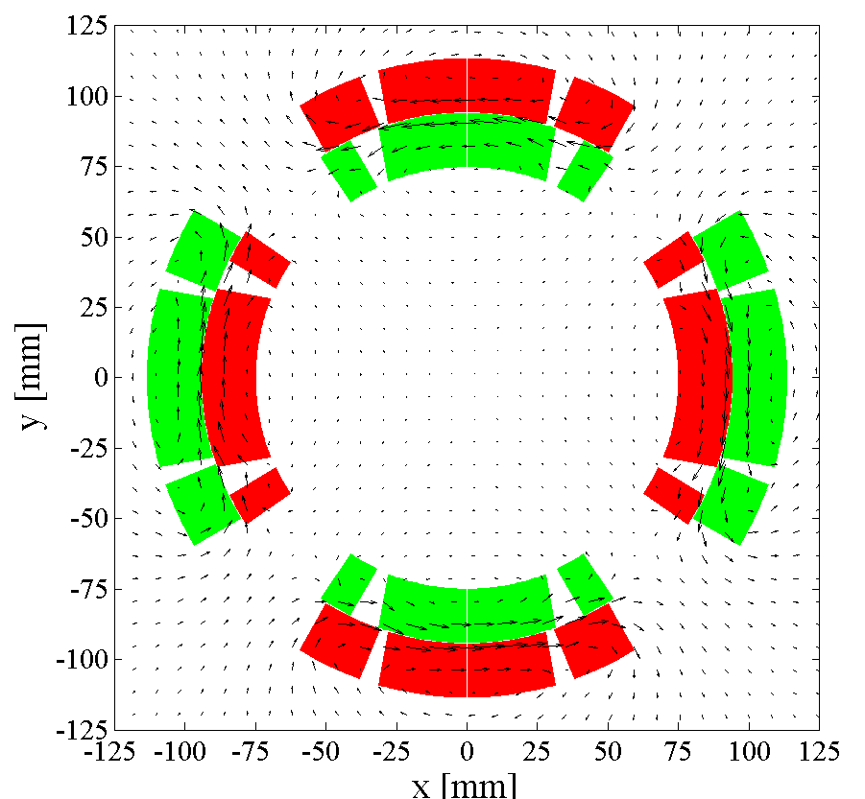
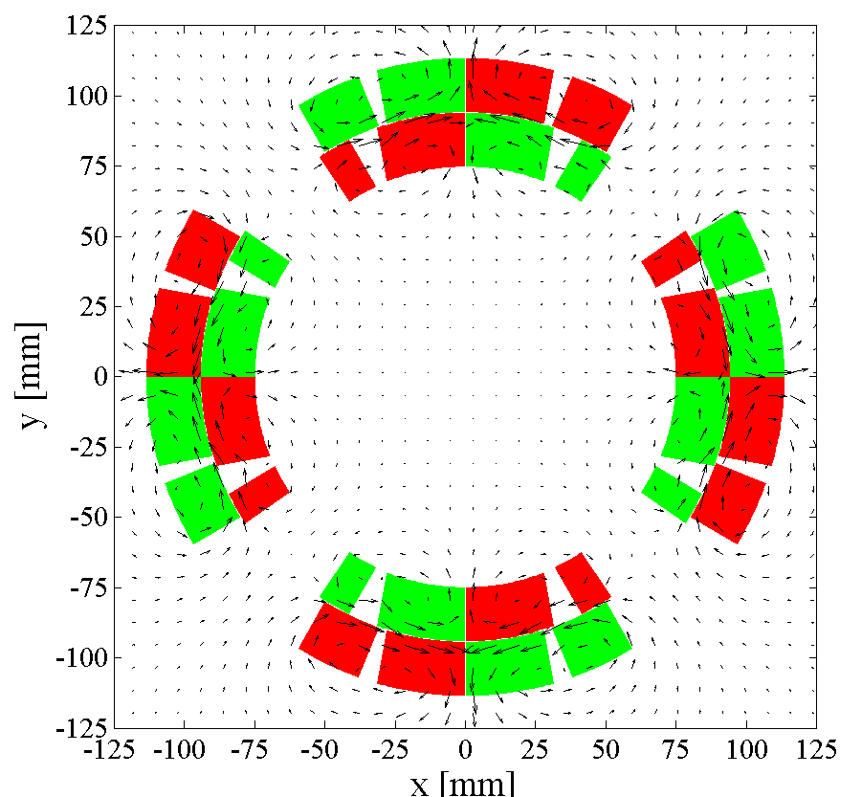
Optimizing CLIQ – Examples of possible configurations
Different configurations can be obtained by varying the electrical order of the poles and the positioning of the CLIQ terminals
Emmanuele Ravaioli - CLIQ tests on SQXF at FNAL LARP Collaboration Meeting - 13 May 2015

Slide 20
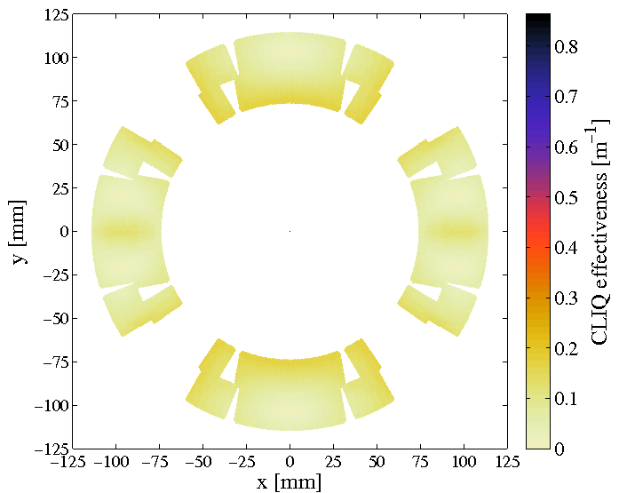
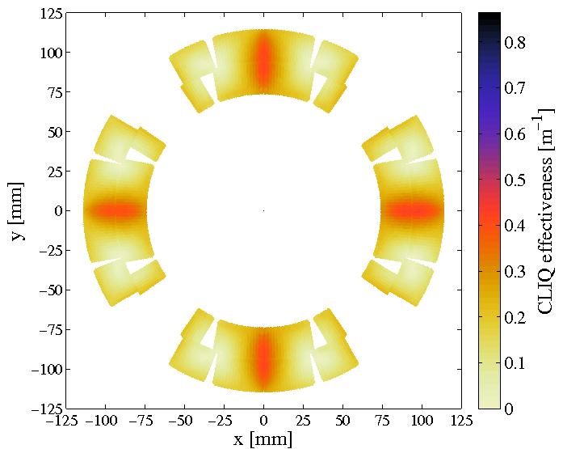
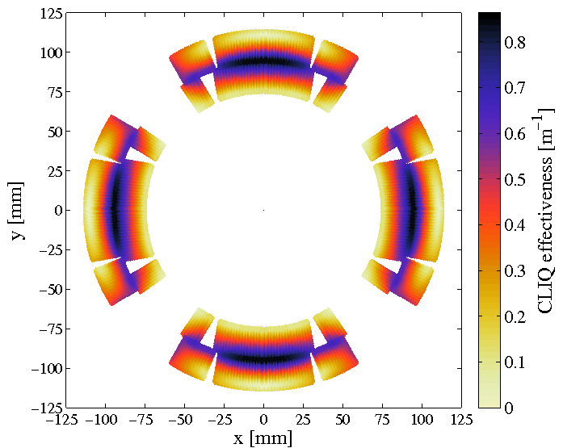
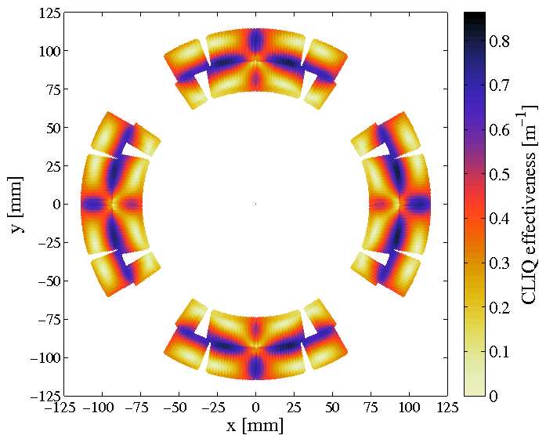
Optimizing CLIQ – CLIQ effectiveness, Ѱ
CLIQ effectiveness, Ѱ
Introduced magnetic-field change, per unit of charging voltage and magnet length
Emmanuele Ravaioli - CLIQ tests on SQXF at FNAL LARP Collaboration Meeting - 13 May 2015

Slide 21
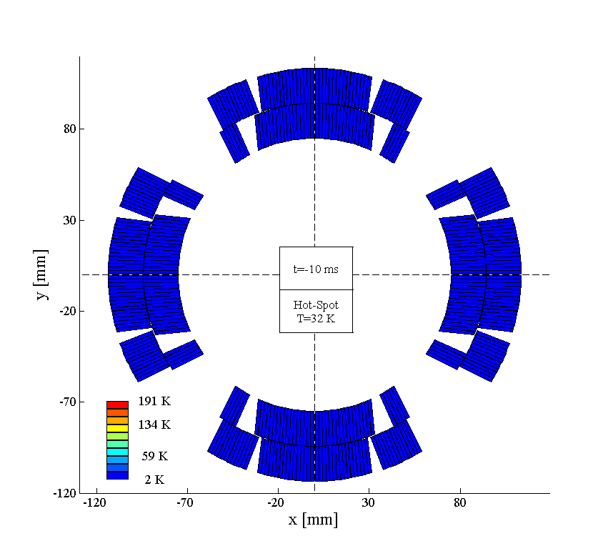
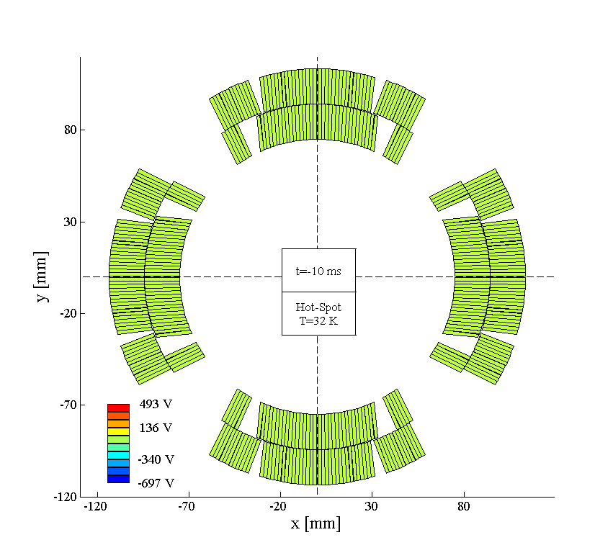
Designing CLIQ – Simulated CLIQ on a 7 m long MQXF
Temperature
Voltage to ground
Emmanuele Ravaioli - CLIQ tests on SQXF at FNAL LARP Collaboration Meeting - 13 May 2015

Slide 22
Protecting full-scale magnets with CLIQ – The strategy
Power per unit volume deposited by CLIQ depends on inter-filament loss (IFCL)
Charging voltage
(limited for safety reasons)
Number of CLIQ units
(for quadrupoles up to 2 units)
Equivalent inductance
of the discharge circuit
→ Coil geometry
→ Position of CLIQ connections
→ Electrical order of the poles
(always an advantage, typically possible with minor changes)
Magnet length
(defined by design)
Capacitance of CLIQ unit
(no effect on power, but
to discharged energy)
For a given quadrupole magnet
Choose optimum CLIQ configuration
Increase voltage U₀
Increase capacitance of CLIQ unit(s)
2-CLIQ
Emmanuele Ravaioli - CLIQ tests on SQXF at FNAL LARP Collaboration Meeting - 13 May 2015

Slide 23
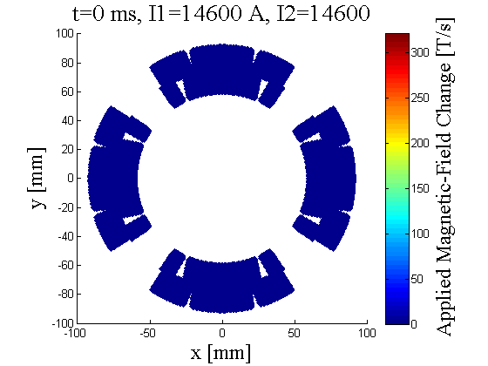
Optimum CLIQ discharge configuration -2
Efficient distribution of magnetic-field change
Not Optimized
Optimized
[a.u.]
[a.u.]
2
1
2
1
3
4
3
4
Golden rule for optimizing any CLIQ discharge circuit
Introduce opposite current change in coils which are physically adjacent
Emmanuele Ravaioli - CLIQ tests on SQXF at FNAL LARP Collaboration Meeting - 13 May 2015

Slide 24
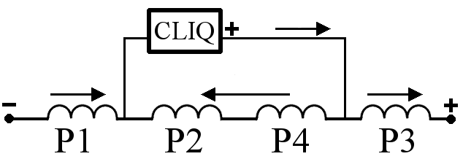
Multi-CLIQ
Further decreasing the impedance of the circuit can be reduced by subdividing the electrical circuit into 2xN_{C} elements, effectively in parallel when CLIQ is triggered.
1-CLIQ
2-CLIQ
Emmanuele Ravaioli - CLIQ tests on SQXF at FNAL LARP Collaboration Meeting - 13 May 2015

Slide 25
Simulation results – I₀ = 17.3 kA (I_{nom})
MQXF
Magnetic Length 6.8 m
Self-inductance 70 mH
Nominal current 17.3 kA
Quadrupole magnet for the LHC high luminosity upgrade
(US-LARP collaboration)
For each studied configuration a minimum capacitance is needed to protect the magnet
As expected performance of
2-CLIQ-500 V
similar to 1-CLIQ-1 kV
Assumptions: no QH; no EE; RRR=140;
10 ms detection time
Emmanuele Ravaioli - CLIQ tests on SQXF at FNAL LARP Collaboration Meeting - 13 May 2015

Slide 26
Simulation results – I₀ = 9 kA (~50% I_{nom})
1-CLIQ-500 V
is not sufficient to protect the full-length magnet
Both 2-CLIQ-500 V
and 1-CLIQ-1 kV are valid protection solutions for C>50 mF
Assumptions: no QH; no EE; RRR=140;
10 ms detection time
Emmanuele Ravaioli - CLIQ tests on SQXF at FNAL LARP Collaboration Meeting - 13 May 2015

Slide 27
CLIQ – Coupling-Loss Induced Quench
Current
Change
Magnetic Field
Change
Coupling-Losses
(Heat)
Temperature
Rise
QUENCH
Principle: When subjected to a magnetic field change, coupling losses occur in superconducting wires and cables. These losses are heat generated directly in the superconductor to quench!
Emmanuele Ravaioli - CLIQ tests on SQXF at FNAL LARP Collaboration Meeting - 13 May 2015

Slide 28
Why do we need to delay the triggering of the extraction-system?
Avoid interference between CLIQ and EE system
Avoid superposition of voltage across CLIQ and across EE resulting in voltage too high
Avoid reducing CLIQ performance
Emmanuele Ravaioli - CLIQ tests on SQXF at FNAL LARP Collaboration Meeting - 13 May 2015

