Slide 1
Impact of Reduced Running on the Test Beam
Mandy Rominsky
Pre-PAC Meeting
29 June 2017

Slide 2
Fermilab Test Beam Facility
A wide range of users
Well over 1000 users and 30 countries represented
2 Beamlines
MTest: Primary and secondary beams, 6 user stations
MCenter: Secondary and Tertiary beams, currently used by LArIAT, NOvA to follow up
FY17 Users

Slide 3
Facility Layout
Beam Areas
Work Areas
Control Rooms
Notes:
Insie, we have 2 beamlines: Mcenter and Mtest, and accompanying control rooms. Mtest typically houses short term (1-2 week) experiments while Mcenter’s users are more long term. In addition to the beamlines and control rooms, we are working on a cosmic ray stand and other user areas not necessarily in a beam enclosure.
2 Beamlines
MTest for short-term (weeks) experiments
MCenter for make-up and long-term (months) experiments

Slide 4
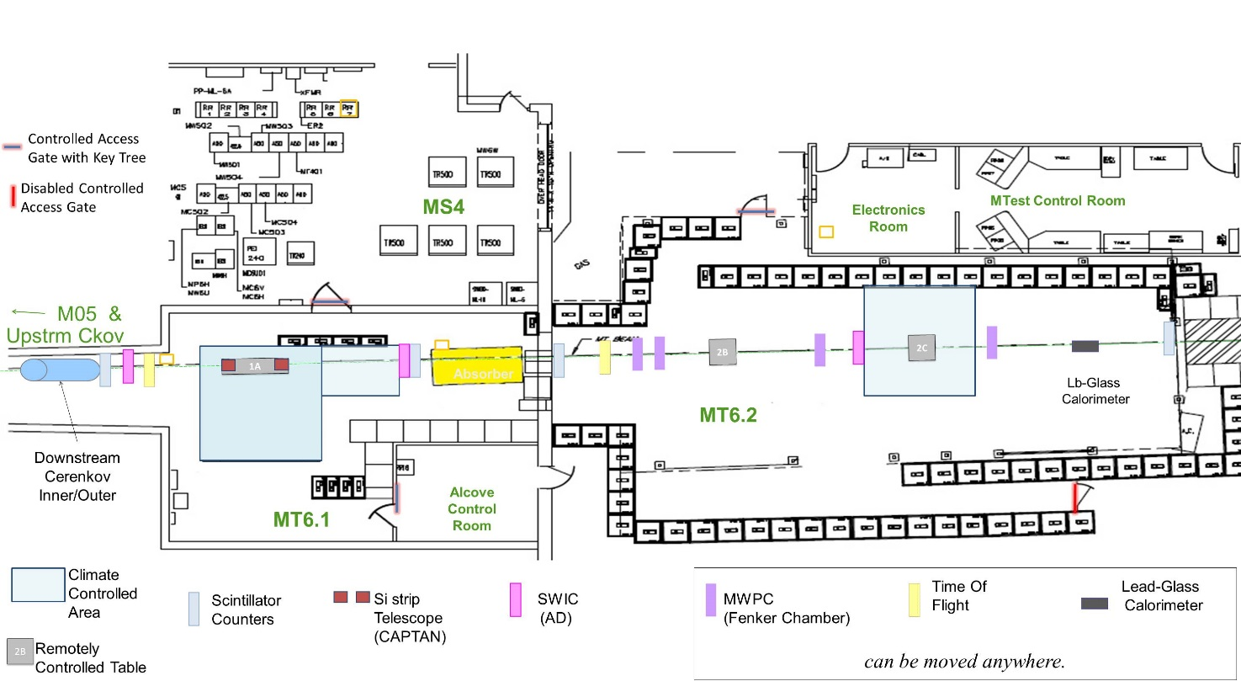
Beam Instrumentation Layout – MTest
Beam Direction
SC1
SC2
MWPC1
MWPC2
MWPC2
MWPC4
Ckv U
Ckv D
Lead Glass
10.47m

Slide 5
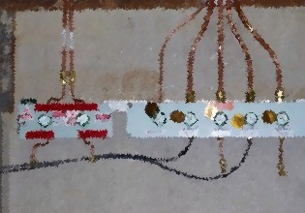
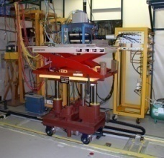
Beam Details and Infrastructure
MTest Beam line
120 GeV protons (primary)
1 – 60 GeV secondary beam
Spot size about 2cm
Energy can be changed in just a few minutes
MCenter Beam line
Tertiary beamline down to 200 MeV
Mainly used for longer term (~months) experiments
Infrastructure available
Remote controlled motion tables, Gas hookups (including flammable) cameras, signal/HV/ethernet patch panels
Cables, supplies, test benches for prep work
Much more, just ask!

Slide 6
FY17 Summary
25 weeks of beam time
Problem with the septa in December/January reduced our beam time
Generally ran 24/7 when beam was available.
Last month of running had 5 experiments in the MTest Beamline
14 experiments
Broad research program
CMS, ATLAS, LHCb, DUNE, LArIAT, Mu2e, IceCube, Generic R&D
5 new experiments
Publications planned for many of the experiments
Full Test Beam report out later this fall

Slide 7
Planned FY18 running - MTest
Users start November 1
Assume 35 weeks of running time
Started taking FY18 requests in May
So far, requests from repeat customers:
25 weeks as primary requested (CMS, ATLAS, PHENIX)
We often will continue to accept requests throughout the run period.
Typically also take a week or two of beam studies
EDIT is scheduled for FY18 and will take up 2 weeks of beam time – Could be delayed or canceled depending on funding
Full schedule can be found: http://web.fnal.gov/experiment/FTBF/Mtest/2018_schedule.aspx

Slide 8
FY18 Current Schedule – MTest
November
Sunday | Monday | Tuesday | Wednesday | Thursday | Friday | Saturday
December
Sunday | Monday | Tuesday | Wednesday | Thursday | Friday | Saturday
January
Sunday | Monday | Tuesday | Wednesday | Thursday | Friday | Saturday

Slide 9
FY18 Current Schedule – MTest
February
Sunday | Monday | Tuesday | Wednesday | Thursday | Friday | Saturday
March
Sunday | Monday | Tuesday | Wednesday | Thursday | Friday | Saturday
April
Sunday | Monday | Tuesday | Wednesday | Thursday | Friday | Saturday

Slide 10
FY18 Current Schedule - MTest
May
Sunday | Monday | Tuesday | Wednesday | Thursday | Friday | Saturday
June
Sunday | Monday | Tuesday | Wednesday | Thursday | Friday | Saturday
July
Sunday | Monday | Tuesday | Wednesday | Thursday | Friday | Saturday

Slide 11
Planned FY18 Running – MCenter
LArIAT will finish July 7
Preparation for the NOvA test beam is ongoing
LAPPDs and other small tests would happen opportunistically
Gaseous TPC (Jen Raaf’s early career) will also install through out this year
Possibly running if time allows
Hadron Production studies
New effort between US and Japan (partially funded)
The hadron production measurements will help reduce neutrino flux uncertainties for T2K, NOvA, MINERvA and DUNE.
Plans to test in both MTest and MCenter

Slide 12
Overall Impacts of Reduced Running
Looked at the scenario where beam is only available for a few months
Looked reduced running from 10% to 5% of the timeline
Asked currently scheduled users what the impact to their physics programs would be with reduced running
Also, in case they couldn’t run their programs
Note that the CERN beam areas are off in 2019 and 2020
Several new groups this year from CERN were very happy and are planning extensive programs back here
Very happy with our high rate tracking area
We are working with a new group using US-Japan Funds that is supposed to start up this year.

Slide 13
Impacts on ATLAS Pixels – Kazunori Hanagaki
Tests for the ATLAS pixel and ASIC upgrades
These can be done at CERN, but limited time as many groups from ATLAS are competing for the same beam time
Testing SOI chips developed by KEK
These cannot be tested at CERN
The last 2 years Kazu’s group received special funding to come to the test beam and work on the SOI chips. The delay this year from the septa caused significant problems for them.
They have funding to come again, as they were successful in the tests ultimately. Delaying their run or canceling it is incredibly detrimental to their research program.

Slide 14
ATLAS Pixel Detector (RD53A) – Jessica Metcalfe
Commonly developed chip used by CMS and ATLAS
Critical testing period coming up this fall
Can use either DESY or SLAC if FTBF or CERN are not available
Planning on building a telescope at the test beam facility sometime in FY18
Will also use this for general R&D
Brings in new ATLAS groups to the test beam

Slide 15
Impacts on sPHENIX – John Haggerty/ Eric Mannel
sPHENIX (upcoming flagship experiment for RHIC) tests for about 4 weeks each year
They have received CD0 from the DOE Nuclear Physics funding agency and are working on testing the final design necessary for CD1 and CD2. They are funded in the FY18 PBR.
The FY16 and FY17 test beam runs have been submitted for publication and is on arXiv (https://arxiv.org/abs/1704.01461)
The final run in FY18 will be used to confirm final design and provide data to characterize the detector in a variety of beam energies

Slide 16
Impacts on CMS HGCal – Jim Freeman and Roger Rusack
This is a test of the High Granularity calorimeter. Considering the possibility of bringing in 5 interaction lengths and setting up a full calorimeter test
These tests will advance the project, but maybe not delay it.
The beamline they use at CERN is being used by DUNE, which cuts down HGCal’s beamtime in FY18
There are no CERN test beams in 2019 and 2020.

Slide 17
Impact on CMS Pixels and Outer Tracker – Lorenzo Uplegger
Testing the CMS pixel detector and Outer Tracker designs
A spread in time is crucial for them
Test sensors, irradiate, then test again
This process takes many months
If currently designed chip fails, it delays detector construction
Also means if they don’t test, detector construction also is delayed
The Outer Tracker is also divided between Fermilab and CERN.
Failed chips will also delay the Outer Tracker

Slide 18
Impact on NOvA Test Beam: Alex Sousa
Impacts the commissioning of the new tertiary beamline for NOvA
These tests are used to reduce the systematics for the NOvA
Maximum impact if the test beam can be completed before Spring 2019
Reduced running or delays will make the test beam less valuable for the mass hierarchy measurement, but still useful for later analyses
However, world wide competition might be caught up by then.

Slide 19
Impact on Gaseous TPC: Jennifer Raaf
Work for an Early Career Award
Doesn’t need much statistics, so a delay or reduction is not a problem
Could possibly switch the order of the tests – run in a neutrino beam first, then the test beam.

Slide 20
Summary
The Fermilab Test Beam Facility impacts R&D efforts across all thrusts of the HEP program and part of the Nuclear Program
We have a committee in place to help with prioritizing experiments in the case of reduced running – but!
We’ve gotten very good at negotiating with users so many can use the beam at the same time
We’ll ask spokespeople/project managers to help with the prioritization
Running at a reduced rate (5%) is preferable to fewer months
Some experiments (CMS) need to be able to irradiate chips and then test.

